Slide 1


Partnership for Supporting High Quality Authorizing:
Small School District Authorizers

Slide 2

A partnership of academic professionals, extensive experience and knowledge about charter authorizing committed to support SSDA members.
SSDA and CCAP…
Notes:
Justin or Tim to present this slide

Slide 3

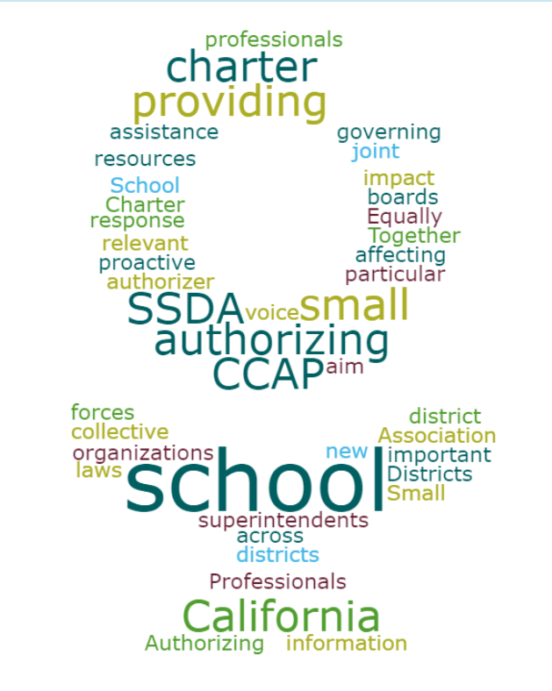
SSDA and CCAP…
A partnership for quality
A shared a common mission of quality authorizing
Building capacity with new legal framework
Providing professional learning opportunities with small school district authorizers as a focus
Sharing relevant information, support, resources, a collaborative voice
Notes:
Tim or Justin to present this slide

Slide 4

About CCAP
Founded by a group of committed authorizers with a mission to advance quality public education for all students
First came together in late 2013, incorporated in late 2014, and received 501(c)(3) status in 2015.
National Dissemination Grant recipient from the U.S. Department of Education’s Office of Innovation to improve charter school authorizing best practices
Partnered with Colorado and Florida to form the Alliance focused on supporting quality authorizing in the three states and across the nation
Notes:
Victor to present this slide

Slide 5
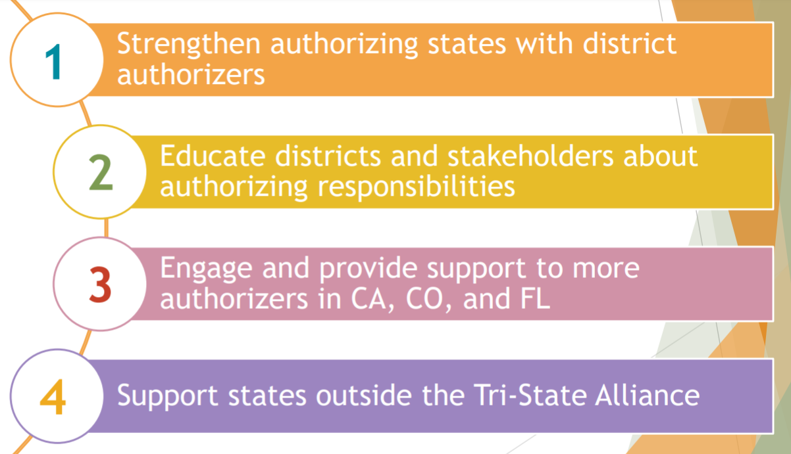
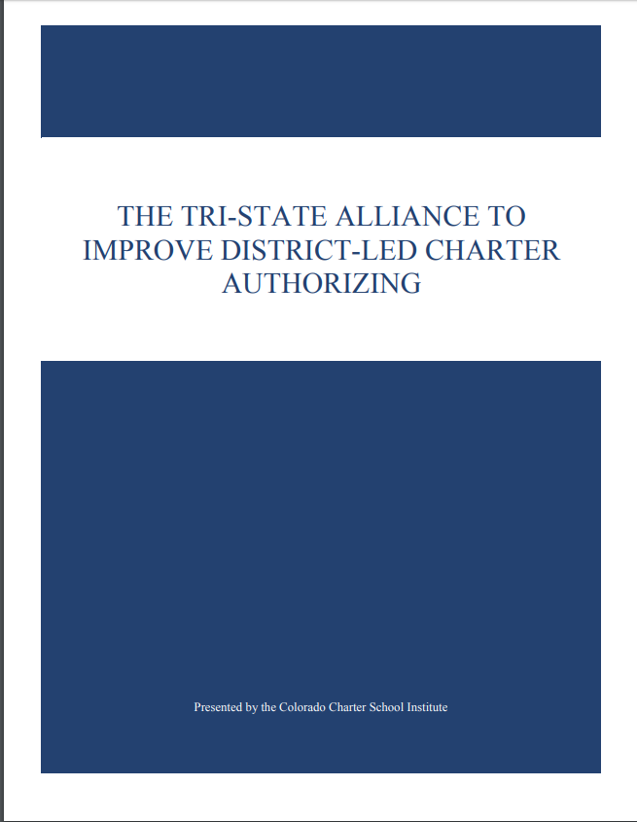
About CCAP’s Grant
Notes:
Victor to present this slide

Slide 6
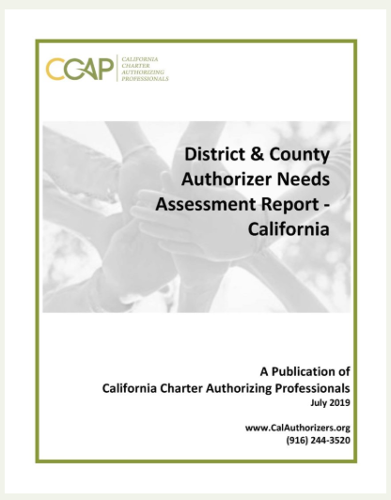
Our latest work
Created and administered the first ever state-wide Authorizer Survey, with interesting results:
A request for two model materials:
    A Toolkit for charter petition review
      With elements addressing the English Learner needs
    A Toolkit for Annual Report to C.S. and a Site Visit Rubric
Notes:
Victor to present this slide

Slide 7

The CCAP Survey Shows…
A need for professional development:
  Annual reviews, renewal evaluation, governance oversight
    A need for differentiated professional development:
      Small/rural vs. authorizers with large portfolios
    Practical applications of the “future [recent]” CA legislative changes in authorizing
    Levels of authorizing addressing advanced issues: replication/expansion/MOUs
    District vs. county authorizers
    Alignment with the state’s accountability system
Notes:
Victor to present this slide

Slide 8
The CCAP Survey Shows…
-Critical Challenges for Small School Districts
A need to address frequent changes in the composition of local school boards
A need to develop clear communication to governing boards and staff regarding oversight responsibility
A need to stay informed with a highly politicized charter school sector and legislative/policy environment in constant flux
A need to improve access, services, and outcomes for English Learners and students with disabilities
A need to develop and share information and ideas
A need to archive materials, templates, and forms
Notes:
Tim or Justin to present this slide

Slide 9
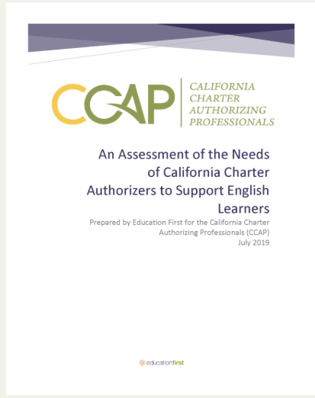
Our latest work
A state-wide study with Education First
A focus on student equity and access by assessing the needs to best support English Learners
Notes:
Victor to present this slide

Slide 10
The Education First Study…
It also calls out barriers affecting English Learners, a future study needed…
@ charter school level
  A decentralized system
  An unclear application process
  Recruitment issues
  A lack of transportation access
  A high level of reclassification
*2017-2018 school year
Notes:
Victor to present this slide

Slide 11
The Education First Study…
It also calls out barriers affecting English Learners, a need for future study… (continued)
@ state level
Enrollment trends
A 2% fewer ELs in urban areas
An 11% fewer ELs in rural areas
A 12% proficiency rate in math and English language arts*
A 70% graduate rate (completing high school in 4 years)
A 15% college and career ready
30%-50% of Els entering Kinder fail to develop English skills needed for academic participation--- after 6 years or more of instruction, they become long-term English Learners (L-TELs)
“EL program needs” not specifically called out on charter school petitions (initial/renewal)
Lack of consistent PD on EL instructional strategies at all levels
*2017-2018 school year
Notes:
Victor to present this slide

Slide 12
The Education First Study… Recommendations for CCAP
Serve as a hub
  Procuring authorizing policies, best practices, materials, research, tools, and offering professional learning opportunities in order to support English Learners
Provide communiqués
  On the new CA legislative requirements
  On the latest EL information to support authorizers’ work
Offer opportunities to collaborate
  To share stories
  To share exemplar tools
  To share evidence-based best practices supporting ELs
Notes:
Victor to present this slide

Slide 13

Takeaways for Today
An overview of authorizing requirements:
Academic, Fiscal and Governance
How the new laws impact authorizer oversight
What supports are available
Future learning opportunities
Notes:
Victor to present this slide

Slide 14

Introducing…
Charter Authorizing 2.0
C2.0
More than updating policies and forms
The focus is on an efficient and effective approach to authorizing and,
Compliance with new laws
Notes:
Dave or Corey to present this slide

Slide 15

Key concepts and Areas of Focus and Design Principles
C2.0
  Design Principles and Key Areas of Focus:
    Academic: Is the academic program successful?
    Financial: Is the school financially viable and sustainable?
    Governance/Management: Is the organization effective and well run?
        Public Policy: Is the organization operating consistent with public policy
Notes:
Dave or Corey to present this slide
Experience in California and throughout the country has shown a limited number of criteria can be used to judge if a charter school is successful. In the most simplistic terms, a charter school is successful if four Core Charter Performance Questions can be answered in the affirmative:
Is the school’s educational program a success?
Is the school financially viable?
Is the organization operating consistent with public policy and
operating effectively?

Slide 16
Key concepts and Areas of Focus and Design Principles (cont.)
C2.0
  Design Principles
    Principle 1 - The role of the authorizer is to approve/deny charter petitions, monitor, assess and intervene as necessary, and approve/deny renewals
    Principle 2 - The first level oversight responsibility for the charter is the responsibility of the charter school boards
    Principle 3 – The process must be transparent to all stakeholders and the public
    Principle 4 - There are fundamental measures of quality that can be identified and measured.
Notes:
Dave or Corey to present this slide
Principle 1
The role of the authorizer is a regulatory role. It approves/denies charter petitions, monitors, assesses and intervenes as necessary, and approves/denies renewals: Consistent with its regulatory role, an authorizer’s core responsibilities are tied to the lifecycle of charter schools . The first part of the lifecycle is charter authorizing, the review of charter petitions submitted to it and make decisions to approve or deny each of them based on the law, regulatory guidance, policy and best practice . The second is the ongoing monitoring of charter schools they have approved regarding their progress towards meeting the criteria for renewal and their compliance with the law. I want to intro the concept of the cs lifecycle. Not sure how to make the case that it is a good organizing concept.
Do I need to define “best practice”, and discuss why it is included?
Principle 2
The first level of oversight responsibility rests on charter school boards: The responsibility for ensuring the proper and successful operation of the charter school rest first and primarily with the governing board of the charter school. If the charter school board fulfills their responsibilities well, the board also builds critically important board capacity and competence. In the normal course of its oversight work an authorizer does not conduct extensive reviews of day-to-day operational activities. The authorizer primary responsibility’s is to monitor, verify the work of the charter school board, and problems are indicated, to take steps so that the charter school resolves the issues.
Principle 3
To be an effective and trusted process, it must be transparent to all. This includes the process where regulatory requirements are developed, to the availability of the rules that are to be followed by all and the performance expectations. By having a transparent process that includes appropriate engagement opportunities for all stakeholders, the process builds confidence in the quality and fairness of the process.
Principle 4
There are fundamental measures of charter school quality that can be identified and measured: Experience and research has shown that there are fundamental measures of quality that can be identified and measured.
There are a limited number of Key Performance Indicators that guide this work and allow it to be done in an efficient manner.
Key Performance Standards are Quantifiable/Measurable, and are
Determined at the Time the Charter School is Authorized and are Known by All.
The process provides appropriate indicators when additional action is needed, and the results from the test(s) informs scope/intensity of the follow up action.
Educational Program Success: The academic performance of the students; both in absolute terms and in terms of student achievement growth, as measured by the California Assessment of Student Performance and Progress (CAASPP) and other reliable and valid measures of student academic performance. In this context Key Performance Indicators define and communicate the fundamental performance characteristics of the school to a wide variety of stakeholders including but not limited to the charter school and its authorizer.
Financial Viability: There is a baseline of fiscal standards that apply to all charter schools. These are based on “fiscal best practices” and are broadly recognized as rigorous but reasonable. There can be a set of modified standards that apply to schools in certain circumstances, such as “new schools”. These fiscal performance indicators are specifically tailored to charter schools but are universally used to evaluate the financial viability of business entities large and small as well nonprofits.
Operating Consistent with Public Policy: Is the organization operating consistent with public policy? This is a developing conversation. It is arising from the tensions that call for all charter schools serve all students and that charter schools can have a specify mission or population they intend to serve. For example, are they open to all, serving all populations equally well?
Operational Success: A baseline of operational standards that apply to all charter schools. These are based on “organizational best practices” and are broadly recognized as rigorous but reasonable. Examples are timeliness and accuracy of regular submissions of information to the authorizer and an effective Human Resources function.
Competence Governance: A baseline of governance standards that apply to all charter schools. These are based on “nonprofit governance best practices” and are broadly recognized as rigorous but reasonable.
These type of indicators have been adopted by a number of high-quality authorizers across the country.

Slide 17
Key concepts and Areas of Focus and Design Principles (cont.)
C2.0
  Design Principles
      Principle 5 - The level/intensity of oversight is based on the charter school meeting/failing key performance indicators.
      Principle 6 - The authorizer provides an Annual Reports that provide the foundation for the renew/not renew decision for the school by the authorizer.
      Principle 7 – Fulfilling the responsibilities of a charter authorizer must be within the capacity of all authorizers.
Notes:
Dave or Corey to present this slide
Principle 5
The level/intensity of oversight is based on the charter school meeting/failing key performance indicators. The charter oversight process is based on a limited number of key performance indicators clearly identified and verifiable, and known to the charter school and the authorizer. These key performance indicators define and communicate fundamental measures of quality. If these key performance indicators are met, less intrusive oversight is possible. Failure to meet these performance indicators (e.g., cash reserve levels, student achievement levels) triggers additional, more detailed and potentially more intrusive reviews. The purpose of the additional reviews are to determine if one or more standard(s) is/are being met on face or through an alternative means, to better identify the level of additional risk that exists, if any, as well as to motivate/support the school as it identifies and implement solutions. If serious issues are found, it is also the basis for the authorizer to start the process for the charter school to “cure” the problems and/or if the problem justifies it, to have the authorizer begin revocation proceedings.
Principle 6
The authorizer provides an Annual Report that provide the foundation for the renew/not renew decision for the school by the authorizer: The work of the authorizer in the context of an annual performance report is twofold. First it is to review and validate data provided by the charter school and data that the authorizer’s own independently collected information (e.g., site visit) and from other sources. The second is to analyze the entirety of the data and produce a written report of the school’s success/progress in meeting the standards set for that school that informs all parties and ultimately guides the renew/not renew decision for the school.
Principle 7
Fulfilling the responsibilities of a charter authorizer must be within the capacity of all entities that serve as authorizers: The oversight process must be able to ensure the quality of education being provided and the responsible and effective use of taxpayer dollars by charter schools. The annual progress report format must effectively answer the four Charter Core Performance Questions (see above), be as complete and self-contained a process as possible, and be effective within the resources and charter authorizing capacity/expertise of all authorizers, including those typically found in a small authorizer district or county office of education.

Slide 18


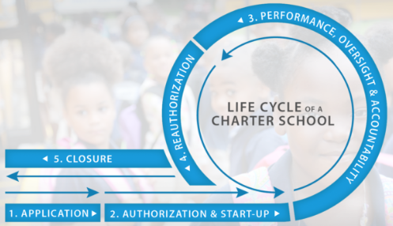
New Laws & Timelines:
  Present changes in the context of Effective Dates and the Lifecycle of Charter Authorizing
Notes:
Dave or Corey to present this slide

Slide 19
New Law: Appeals to County Board of Education
Appeal to County Board must be submitted within 30 days of denial by District
Petitioner must provide a copy of appeal petition to District
If new or different material terms are included in the appeal, the County shall immediately remand to District for reconsideration, and the District board has 30 days to grant/deny
  Material terms: signatures, affirmations, disclosures, documents, and descriptions; not administrative updates due to changes in circumstance based on the passage of time related to fiscal affairs, facilities, or state law, or to reflect the County Board as the authorizer
If District board denies again, Petitioners may resubmit to County Board
County Board reviews substance of charter.; If the District denies based on #8 (fiscal impact), the County Board must also review those findings
Notes:
Dave or Corey to present this slide

Slide 20
Takeaways:
County Board will still reviews petitions on appeal de novo
The law clarifies that petitions submitted to the County on appeal may only include minor necessary changes
Problem areas cannot be “fixed” between District and County reviews
Notes:
Dave or Corey to present this slide

Slide 21
Current Law: SBE Appeals
If a County Board denies a petition, the petition may be submitted to the State Board of Education on appeal
SBE conducts a de novo review of the petition
Appeal must be submitted within 180 days
Public hearing and presentation at ACCS and SBE
SBE assigns oversight if petition is approved
Notes:
Dave or Corey to present this slide

Slide 22
New Law: SBE Appeals
Appeal petitions must be submitted to SBE within 30 days of County denial
The appeal must include a documentary record from District and County denials and citations to the record regarding how the District/County action was an “abuse of discretion”
The documentary record, including transcripts of the meeting at which the petition was denied, must be prepared by the District/County within 10 business days of Petitioner’s request
If the appeal petition includes new or different material terms, SBE shall immediately remand to the District for reconsideration, and the District must grant or deny within 30 days.
The District/County may submit a written response in opposition within 30 days, also citing to the documentary record
The Advisory Commission on Charter Schools (ACCS) shall hold a public hearing to review appeal and documentary record and submit a recommendation to the SBE whether there is sufficient evidence to hear the appeal or to summarily deny
If no ACCS recommendation, SBE shall either hear the appeal or summarily deny review based on documentary record
If SBE reverses denial, it will designate local authorizer
Notes:
Dave or Corey to present this slide

Slide 23
Takeaways
New standard of review is “abuse of discretion” (not de novo) for appeals to SBE
District and County must be ready to make transcripts and prepare documentary record upon request
Process requires careful attention to timelines and documents; strong documentation more important than ever
Phasing out of State Board authorized charter schools
Notes:
Dave or Corey to present this slide

Slide 24
New Law: Countywide Benefit
Clarifies what constitutes “receipt” of charter petition that triggers timelines
Requires recommendations and findings to be published 15 days in advance of County Board action
Same additions (Sp. Ed. and EL) to racial and ethnic balance element of charter petition
Same teacher credential requirements, but countywide benefit charter schools already do not have flexibility in credentialing
Notes:
Dave or Corey to present this slide

Slide 25
New Laws & Timelines:
  Effective January 1, 2020
    Moratorium on non-classroom base - some limited exceptions
    SB 126 Transparency - codifies Attorney General Opinion) regarding the Brown Act, 1090, Political Act, Public Records Act (exceptions – multiple schools multiple counties, teachers)
Notes:
Dave or Corey to present this slide

Slide 26
New Laws & Timelines:
  Effective July 1, 2020
    Approval Process: “Serve Interest of community;” Racial and Ethic Balance must include SPED and EL; two additional reasons to deny (“service interest of entire community,” qualified/ neg. budget); names and qualifications of Board); “Deemed complete” by petitioners, timeline extended to 90 days; 15 days to post staff report; equal time at decision hearing; 30 days to appeal to COE; appeal process to SBE based on procedural review.
Notes:
Dave or Corey to present this slide

Slide 27
New Laws & Timelines:
  Effective July 1, 2020
    Renewal Process: Three-tier approval primarily based on dashboard (2 consecutive year prior)
    Top tier simpler process, “must approve” (5-7 years);
    Middle tier – multiple data points, dashboard primary (“clear and convincing” 5 years);
    Bottom tier “must deny”
      Unless exceptions, 2 years: DASS schools' exceptions; CDE to provide enrollment data to be considered
Notes:
Dave or Corey to present this slide

Slide 28

Fiscal Cycle
Decide How and What to Measure
Create Industry Standards
Prepare Measurement Tools
Rate Progress
Monitor and Adjust Throughout the Year
New Generation of Fi$cal Tools

Slide 29
Measuring the Fiscal Health of a Charter School
Two Groups”
Fiscal Indicators
Classifications
Financial Metrics
New Generation of Fi$cal Tools
Fiscal indicators: Near Term, or Sustainability
Financial Metrics: Cash flow and cash equivalents, or
Financial Statement

Slide 30
Fiscal Indicators
New Generation of Fi$cal Tools
Near Term | Sustainability
Cash on hand | Debt Ratio
Cash flow projections | Budget vs. Actuals
Burn rate | Deficit Spending
Enrollment –projected vs. actual | Current Ratio (assets/liabilities)
ADA – projected vs. actual | Interim reports/audits
Capital structure (assets and ability to secure short-term loans) | Internal controls
Reporting systems and timeliness of information for decision-making | Proper oversight
 | Experience and knowledgeable leadership and in key positions

Slide 31
A Framework for Fiscal Indicators, Fiscal Health and Financial Performance
New Generation of Fi$cal Tools
Fiscal Indicators fall in two classes
  Near-term
  Sustainable
  Evaluation should include trends in financial performance
Financial Metrics
  Select the right metrics to measure
  Each metrics measures a specific characteristic at a point in time
  Best practice is look at the whole picture including historical trends over time
Notes:
Debi to present this slide

Slide 32
Fiscal Health
New Generation Fi$cal Tools
Implementation of best practices
Identify key metrics for fiscal sustainability
Evaluation tools to measure historical trends utilizing fiscal indicators
Notes:
Debi to present this slide

Slide 33
Financial Performance
New Generation Fi$cal Tool
Fiscal tools and framework
  CCAP Toolkits
  Corelates with NACSA key elements
  FCMAT’s Fiscal Risk & Health Analysis
    A Self Evaluation tool
Notes:
Debi to present this slide

Slide 34



What’s Next?
  An invitation to join CCAP
  Additional training – Tell us what you need
Notes:
Victor to present this slide

Slide 35






Resources
  CCAP website
  CCAP’ Office Hours
  National CS clearinghouse
  NACSA
  CCAP Direct Support
Notes:
Victor to present this slide

Slide 36

Evaluation
Quick survey
  What worked?
  What didn’t?
  What should we do different?
Notes:
Victor to present this slide

Slide 37

Thank you
Visit our website
calauthorizers.org
https://calauthorizers.org/
Notes:
Tim, Justin or Victor to present this slide

