Slide 1
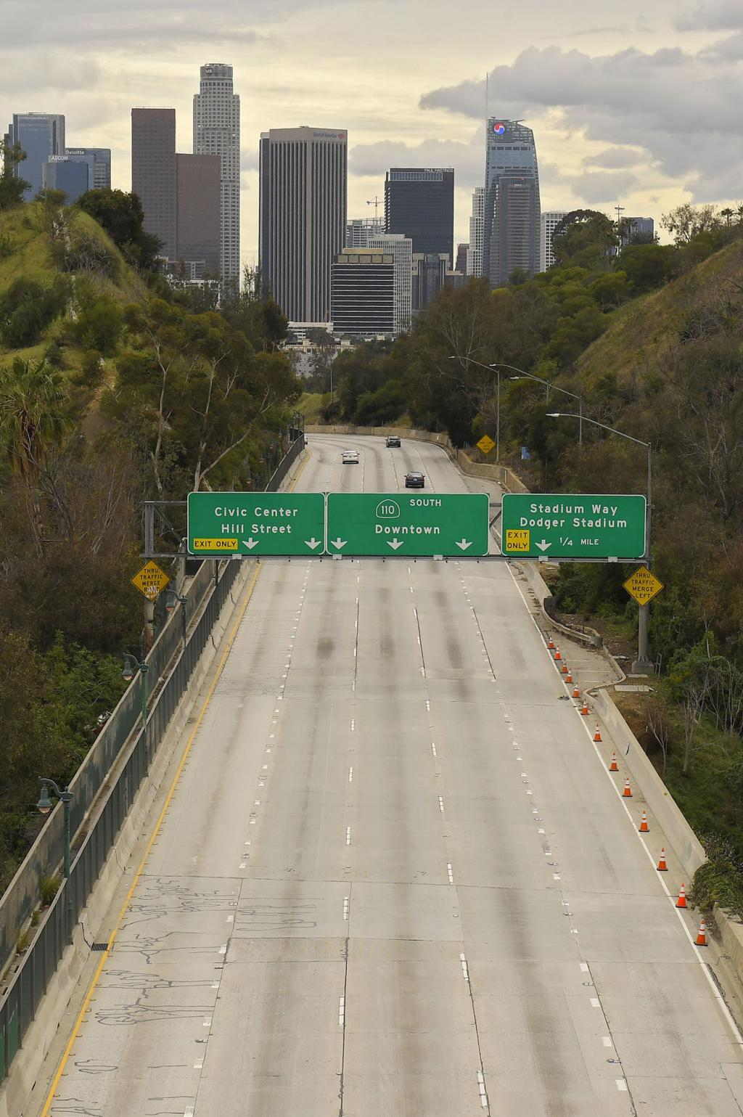
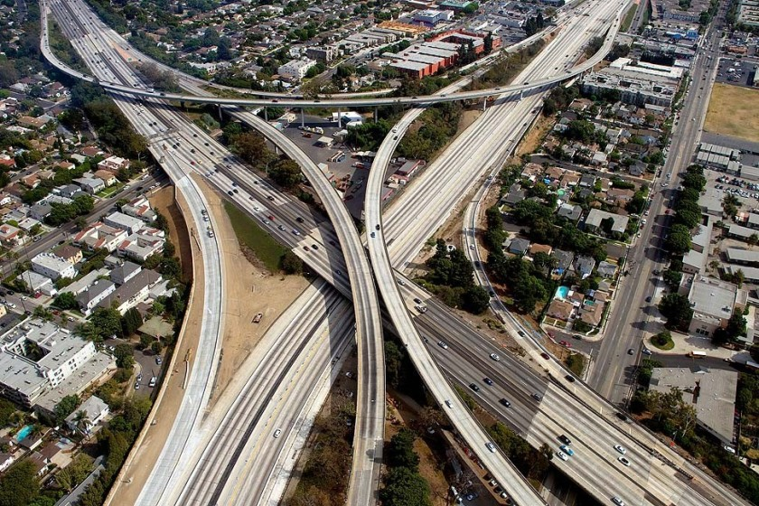
The California Charter
Authorizing Professionals
Webinar Series
COVID-19 Update
America Takes a Pause
Notes:
Victor

Slide 2
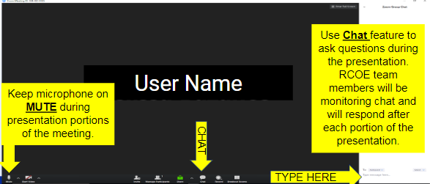

Zoom Functionality
CCAP
Notes:
Victor

Slide 3
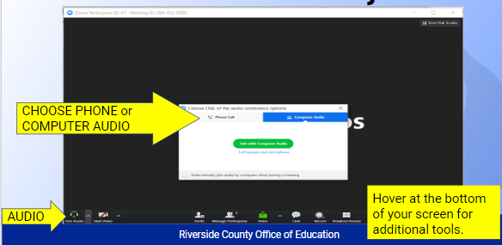
Zoom Functionality
Notes:
Victor

Slide 4

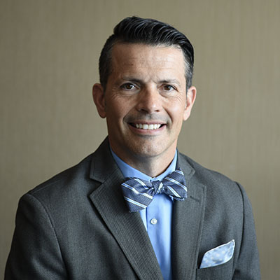
Dr. Corey Loomis, CCAP VP/ RCOE Charter Schools Director
Notes:
Corey

Slide 5
About CCAP
Founded by a group of committed authorizers with a mission to advance quality public education for all students
National Dissemination Grant recipient from the U.S. Department of Education’s Office of Innovation to improve charter school authorizing best practices partnering with Colorado and Florida
Notes:
Victor

Slide 6

Take Away for Today
Information to share with your charters
Lean in on how charters are tracking expenditures and processing waivers
The importance of CASH reserves for charters

Slide 7




For Today
Notes:
Corey

Slide 8
Topics to be covered
Federal/National Perspective
California Focus
What should authorizers know?
What can authorizers do?
Notes:
Corey

Slide 9
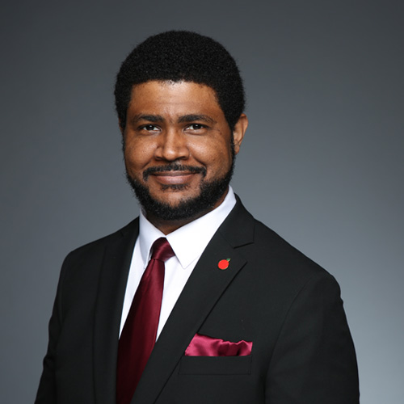
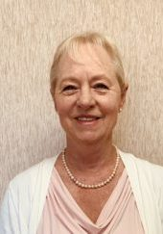
Speakers
Dr. Karega Rausch
NACSA, Vice President of Research and Evaluation & Acting President and CEO
Debi Deal
CCAP Board Member/
Fiscal Consultant
Notes:
Corey- intros

Slide 10
Dr. Karega Rausch
NACSA, Vice President of Research and Evaluation & Acting President and CEO
Notes:
Corey- intros

Slide 11
Key Points
Background
What is happening at the Federal level?
Any modifications/suspensions for IDEA (SPED)?
What is the landscape at the national level?
What should authorizers be doing?
What should authorizers not be doing?
NACSA and other resources

Slide 12


Slide 13
Debi Deal
CCAP Board Member/
Fiscal Consultant
Notes:
Corey- intros

Slide 14
Fiscal Update
History
Today
Future
Debi Deal,
CCAP Board Member/
Fiscal Consultant
Notes:
Debi

Slide 15
What History Told Us
How State Budget Reacts With Economic Changes
CA State Budget
Personal Income Tax
Corporate Taxes
Sales Taxes
Notes:
Debi

Slide 16
Volatility of the State Budget
When any one of these taxes drop, there are impacts to the state budget which impacts K-14.
When all three drop, we are in for a bumpy ride, so fasten your seat belts!
The downward trajectory is quick, recovery is slow.
Notes:
Debi

Slide 17
Recovery
It took 7 years to restore school districts and charter schools to the 2008-09 funding levels.
This was in a strong economy.
Charter schools with limited cash reserves were hit the hardest. They factored receivables, took loans with high interest rates and many closed.
Notes:
Debi

Slide 18
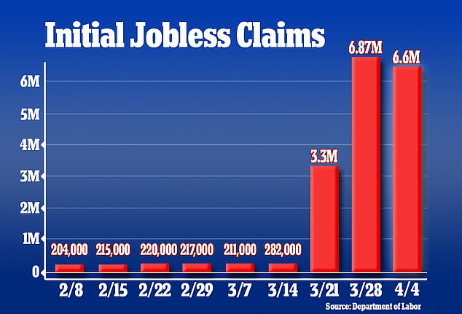
National Unemployment Claims Week Ending April 4, 2020
10% of America's workforce is unemployed
6.6 million filed new claims in one week
3-week jobless total over 17 million
From: Department of Labor

Slide 19
California Surge in Unemployment Claims
Week Ending April 6, 2020
1.9M new claims in just 3 weeks - total for the 2008 Great Recession was 2.2M
1 in 9 workers in CA have filed claims. This doesn’t include those that have been reduced in hours
Some regional areas are above 15%

Slide 20
Fiscal Update
CDE Waivers & Information
There are two possible scenarios for attendance:
  A “material decrease” in attendance is only needed for losses of attendance that occurred prior to the end of a LEA’s last full school month up to February 29, 2020.
  “School Closure” after February 29, 2020 will be included in the CDE waiver form for the number of days of closure – “Coming Soon.”
Notes:
Debi

Slide 21
Fiscal Update
CDE Waivers & Information
Governor’s Executive Order N-26-20 includes guidance on attendance:
  Establishes that P-2 and P-Annual will be as of February 29, 2020
  Instructional Days & Required Minutes – CDE form is not out yet
  Requires waivers!
Notes:
Ed

Slide 22
Fiscal Update
Attendance
Attendance – this link has questions/answers including this section as of April 3, 2020:
  When calculating attendance for programs with a fixed divisor for P-2 and Annual, LEAs will need to determine their last full school month through February 29, 2020.
  Depending on the start date of the LEA's calendar and whether or not they include all, one or none of the school weeks used for winter break, their last full school month will end on either February 7, February 14, February 21, or February 28, 2020.
  Once the end of the last full school month up to February 29, 2020 is determined, the LEA should calculate the difference in number of school days between the last full school month through February 29, 2020 and what their last full school month would have been under the original P-2 cutoff date of April 15, 2020.
Notes:
Debi

Slide 23
Fiscal Update
Attendance
  If the February cutoff date is February 7, 2020, the LEA’s original cutoff date is April 3, 2020.
  If the February cutoff date is February 14, 2020 the LEA’s original cutoff date is April 10, 2020.
  If the February cutoff date is February 21, 2020, the LEA’s original cutoff date is March 20, 2020.
  If the February cutoff date is February 28, 2020 the LEA’s original cutoff date is March 27, 2020.
  To calculate the divisor used for the February 29, 2020 cutoff period for P-2 and Annual, LEAs operating a fixed divisor program should subtract the number of school days between their last full school month through February 29, 2020 and their last full school month through April 15 from 135. The result is the divisor to be used for calculating ADA for the P-2 and Annual reporting periods for the fixed divisor programs.
*P-2 is due to CDE by May 1, 2020
Notes:
Debi

Slide 24
Fiscal Update
Child Nutrition Waivers
On March 27, 2020, the U.S. Department of Agriculture (USDA) issued the following Child Nutrition Programs (CNP) flexibility waivers as part of the COVID-19 Child Nutrition Response Act:
COVID-19: Child Nutrition Response #7, Nationwide Waiver of Monitoring Requirements for Sponsors in the Child and Adult Care Food Program (CACFP).
COVID-19: Child Nutrition Response #8, Nationwide Waiver of Monitoring Requirements for State Agencies in the Child and Adult Care Food Program (CACFP).
COVID-19: Child Nutrition Response #9, Nationwide Waiver of Monitoring Requirements in the School Meals Program.
COVID-19: Child Nutrition Response #10, Nationwide Waiver of Monitoring Requirements for Sponsoring Organizations in the Summer Food Service Program (SFSP).
COVID-19: Child Nutrition Response #11, Nationwide Waiver of Monitoring Requirements for State Agencies in the Summer Food Service Program (SFSP).
Notes:
Ed

Slide 25
Fiscal Update
State Funding
$100M – Senate Bill 117 (SB 117) COVID-19 LEA Response Funds
Based on Classroom-based ADA at P-1.
  Nonclassroom-based charters are EXCLUDED
Allocations are posted on CDE’s website checks are in the mail!
Notes:
Debi

Slide 26
The Future
  Budgeting for 2020-21 and beyond will involve major uncertainty. Assumptions will change as information is known.
  Developing a baseline budget – just the basics and prepare multiple assumption models.
  Adjust assumptions; plan for possible deficits, deferrals and cuts.
  Cash flow management will be critical for charter schools because there is no “hold harmless” provision and no state loans.
  Build cash reserves as quickly as possible.
Notes:
Debi

Slide 27

Forecasting the Future
What the Experts Say
UCLA Senior Economists David Shulman says:
  “Real GDP is on track to decline in the second quarter by 7.5% from the previous quarter.”
Legislative Analyst Office –update as of April 5, 2020
  https://lao.ca.gov/Publications/Report/4216
Department of Finance has already issued a letter to state agencies with “no expectation of full funding.”
Notes:
Debi

Slide 28
Authorizing Guidelines to Charters
Consider :
  Develop a unified message to all charter schools for budget assumptions.
  Ensure charters know about the waivers and timelines.
  Ensure charters are capturing expenditures for reimbursement into the new Resource Code 7388.
  Plan for an economic downturn.
  Train charters on cash flow management.
Notes:
Debi

Slide 29
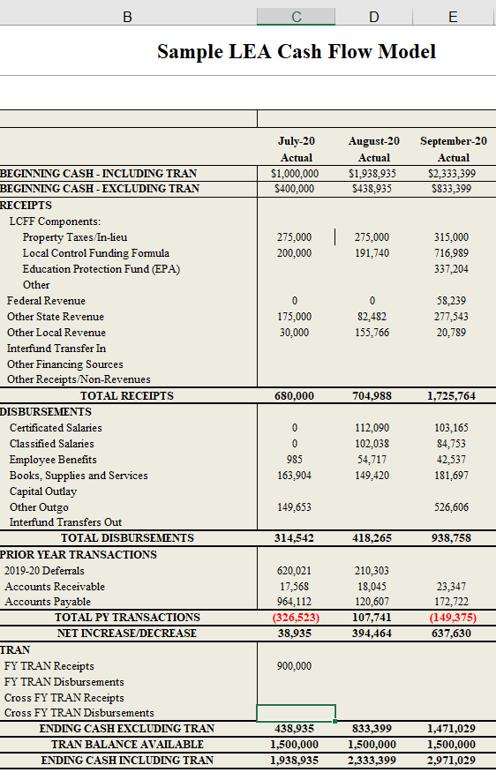
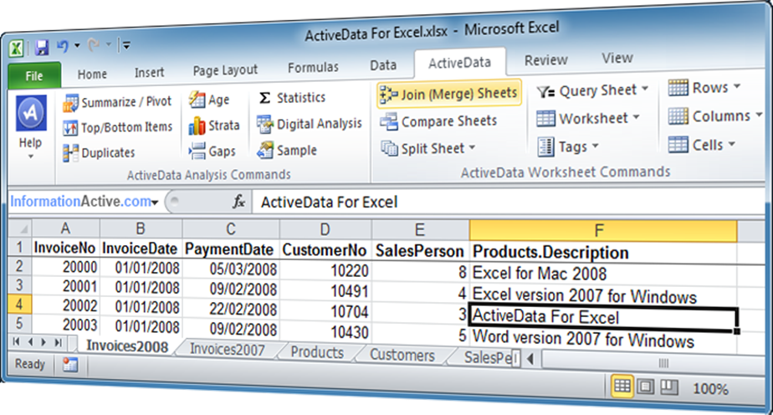

Some Tools to Share
Cashflow
Cashflow
Analytical Tools-ActiveData For Excel

Slide 30
CCAP Cashflow Model

Slide 31
CCAP Cashflow Model
This resource is offered at no cost.
It was developed to include 2 fiscal years.
A separate webinar training will be offered.
Additional technical support assistance is available at no cost.

Slide 32
ActiveData for Excel
ActiveData for Excel contains over 100 enhancements to Excel and delivers a comprehensive set of data analytics including.
This is a software “add-on” to your existing Excel program for enhanced functionality.
The company is offering our members a 10% discount.
support@informationactive.com

Slide 33

Notes:
Corey

Slide 34




Authorizers’ Role
Notes:
Corey

Slide 35
Next Steps and Resources
Stay Tuned!
    CCAP Library
    Tune into our “Office Hours”
    Continued Fiscal Updates
    Cashflow Training – April 27th at 1:00PM
Notes:
Victor

Slide 36





Resources
  CCAP website: www.calauthorizers.org
  CCAP’s Office Hours: April 23rd and May 5th 12:00 p.m. – 1:30 p.m.
  CDE Spec Guidelines
  Questions to Consider (COVID-19 issues)
  CCAP Direct Support
Notes:
Victor

Slide 37


Thank you to our Speakers!
Dr. Karega Rausch
NACSA, Vice President of Research and Evaluation & Acting President and CEO
Debi Deal
CCAP Board Member/
Fiscal Consultant
https://www.charterschoolcenter.ed.gov/sites/default/files/images/field_global_image/NAC.jpg
Notes:
Victor

Slide 38


