Slide 1
The California Charter Authorizing Professionals
Webinar Series: COVID-19 Update #5
The May Revision
Notes:
Victor

Slide 2
Zoom Functionality
CCAP
Notes:
Victor

Slide 3
About CCAP
Founded by a group of committed authorizers with a mission to advance quality public education for all students
National Dissemination Grant recipient from the U.S. Department of Education’s Office of Innovation to improve charter school authorizing best practices partnering with Colorado and Florida
Notes:
Victor

Slide 4
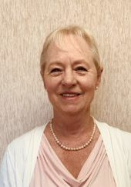
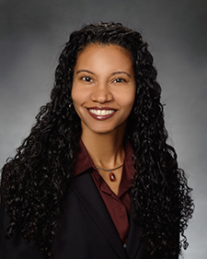
Speakers
Debi Deal, CCAP Treasurer/Fiscal Expert
debi.deal@calauthorizers.org
Brianna Garcia, CCAP Board Member/Director, School Services of California, Inc.
brianna.garcia@calauthorizers.org
Dr. Corey Loomis, VP CCAP/ RCOE Charter Schools Unit Director
corey.loomis@calauthorizers.org
Notes:
Corey- intros

Slide 5
2020 May Revision Update

Slide 6
California Revenues
The May Revision assumes that the state will suffer from a $41.2 billion loss in revenues compared to January estimates in 2019–20 and 2020–21 combined
-$9.1 billion for 2019–20
-$32.2 billion for 2020–21
Revenue losses are compounded by the growing number of Californians who need access to state safety net services, bringing the state’s total shortfall to $54 billion

Slide 7
Proposition 98 Funding
Source: 2020–21 Governor’s Budget, pg. 68 and data provided by the DOF

Slide 8
Statutory COLA
While the May Revision acknowledges a 2.31% statutory cost-of-living adjustment (COLA) (up slightly from the 2.29% estimated COLA in January), it suspends the COLA for 2020–21
Categorical programs outside of the LCFF will also have the statutory COLA suspended
Foster Youth
American Indian Education Centers & Early Childhood Education Programs
Mandated Block Grant
Child Nutrition
Preschool
Special Education
In typical years, as costs continue to rise, these programs would see adjustments for COLA only and average daily attendance (ADA) for special education

Slide 9
Deferrals: Here We Go Again
Cash deferrals were used during the Great Recession to implement state-level budget cuts and/or improve the state’s cash position
The Governor’s May Revision takes a page from the same playbook and proposes the following cash deferrals:
Local school agencies may need to implement local borrowing options to ensure adequate cash to continue paying employees and vendors during these times
While this avoids an additional cut in state revenues to schools, it pushes the administrative and financial burden of borrowing cash to local school agencies
Fiscal year 2019–20
Fiscal year 2020–21
$1.9 Billion
$1.9 Billion
$5.3 Billion
$5.3 Billion
June 2020
July 2020
April, May, and June 2021
July 2021?

Slide 10
2020–21 LCFF Funding Factors
The May Revision suspends the 2.31% COLA and includes an additional reduction—for a total of 10% cut to the Local Control Funding Formula (LCFF)
First, the 2.31% COLA is applied to arrive at the 2020–21 base grants
Then the 10% reduction is applied—for an effective reduction of 7.92% to the 2019–20 base grant amounts
These reductions would be “triggered off” if the federal government provides sufficient funding to backfill the cuts
Grade Span | 2019–20 Base Grant per ADA | 2.31% COLA | 2020–21 Base Grant per ADA | 10% Reduction | Effective 2020–21 Base Grant per ADA
K–3 | $7,702 | $178 | $7,880 | [-$788] | $7,092
4–6 | $7,818 | $181 | $7,999 | [-$800] | $7,199
7–8 | $8,050 | $186 | $8,236 | [-$824] | $7,412
9–12 | $9,329 | $215 | $9,544 | [-$954] | $8,590

Slide 11
2020–21 LCFF Funding Factors
Two grade span adjustments (GSAs) are applied as percentage increases against the effective base grant amounts
Grades K–3 receive a 10.4% increase for smaller average class sizes
Grades 9–12 receive a 2.6% increase in recognition of the costs of career technical education coursework
Grade Span | Effective 2020–21 Base Grant per ADA | GSA | 2020–21 Adjusted Base Grant per ADA
K–3 | $7,092 | $738 | $7,830
4–6 | $7,199 | - | $7,199
7–8 | $7,412 | - | $7,412
9–12 | $8,590 | $223 | $8,813

Slide 12
2020–21 LCFF Funding Factors
The cuts are meant to reduce the LCFF with the reduction taken from the base grant, which lowers the amount upon which supplemental and concentration grant funding is calculated
Grade Span | 2020–21 Adjusted Base Grant per ADA | 20% Supplemental Grant* per ADA—Total UPP after 10% base grant reduction | 50% Concentration Grant* per ADA—UPP Above 55% after 10% base grant reduction
K–3 | $7,830 | $1,566 | $3,915
4–6 | $7,199 | $1,440 | $3,600
7–8 | $7,412 | $1,482 | $3,706
9–12 | $8,813 | $1,763 | $4,406
*Calculated based on the percentage of a local educational agency’s (LEA’s) enrolled students who are English learners, free or reduced-price meal program eligible, or foster youth—the unduplicated pupil percentage (UPP)

Slide 13
2020–21 LCFF Add-On Reductions
In addition to the base, supplemental, and concentration grants, all of the following LCFF add-on funding will also receive a 10% reduction
Targeted Instructional Improvement Grants
Education Code Section (EC §) 42238.02(g)
Minimum State Aid
EC § 41544
Home-to-School Transportation
EC § 42238.02(h)
Basic Aid Supplement
EC § 47663
Economic Recovery Target
EC § 42238.025
District of Choice
EC § 48310

Slide 14
Categorical Program Cuts
Total savings of $352.9 million by cutting categorical programs roughly in half
Cuts may be reversed if additional federal funds materialize
Programs reduced by the following amounts:
After School Education and Safety: $100 million
K-12 Strong Workforce Program: $79.4 million
Adult Education Block Grant: $66.7 million
Career Technical Education Incentive Grant Program: $77.4 million
Career Technical Education Initiative: $7.7 million
California Partnership Academies: $9.4 million
Clean Technology Partnership: $1.3 million
Specialized Secondary Program: $2.4 million
Online Resource Subscriptions for Schools: $3 million
Agricultural Career Technical Education Incentive Grant: $2.1 million
Exploratorium: $3.5 million

Slide 15
Historical Lottery Funding Reductions
During the great recession Lottery funding was also reduced due to the economical distress felt by so many Californians
Between 2006–07 through 2009–10 the biggest loss was to the restricted Lottery (instructional materials) portion of the Lottery funding from $27.90 per ADA down to $13 per ADA (53%) in that period of time
Full restoration of pre-recession funding did not occur until 2012–13
Prudent Lottery projections should include a reduction in expected funding as part of the multiyear projection based upon historical trends

Slide 16
Special Education
Reflects a 15% increase over the amount provided in 2019–20 budget
Base Rates increased to $645 per ADA based on three-year rolling average ADA
Reflects suspension of 2.31% COLA
Maintains all other existing
categorical programs in the Assembly Bill 602 formula until a finalized formula is adopted
Maintains Special Education Local Plan Area Governance and Accountability Structure

Slide 17
CARES Act Funding
Preliminary estimates show that California will be receiving more than $1.6 billion to support school districts and charter schools
State is required to pass-through at least 90% of those funds
Funds will be allocated based on Title I, Part A allocations for 2019–20
Initial calculations show that eligible recipients will receive funding equal to 83% of their 2019–20 Title I allocation
Secretary DeVos also announced the creation of two competitive grant strands to support recovery from the pandemic
Rethink K–12 Education Models Grant—$180 million
Reimagining Workforce Preparation Grant—$127.5 million
More information on these grants can be found here: https://oese.ed.gov/offices/education-stabilization-fund/states-highest-coronavirus-burden/
Notes:
$13.5 of the $31 billion is allocated through the Education Stabilization Fund which will be distributed to States based on Title I allocations. California’s share of these dollars is more than $1.6 billion. The funds, which must be requested by the LEAs through an application process, will also be allocated based on the 19-20 Title I, Part A allocations.
Recent guidance from CDE states that although the application is not yet available, the funds will be apportioned in fiscal year 2020-21, and LEAs should use resource code 3210 to track the revenues and expenditures.
In addition to these funds, Secretary DeVos announced two competitive grants to aid in the recovery from the COVID-19 pandemic.

Slide 18
The CARES Act – One-time Investments
$4.4 billion for LEAs to mitigate learning loss
$355 million GEER funds
Allocated to LEAs using formula that considers state’s most vulnerable students
Funds shall be expended by December 30, 2020 on the following activities:
$4 billion from Coronavirus Relief Fund
Extending the instructional school year
Additional academic services
Learning supports
Wrap around services
$1.5 billion distributed per pupil based on number of students with a disability
$2.855 billion to concentration grant LEAs on a per ADA basis
SSC estimates to be $1,900 per student
SSC estimates to be $735 per ADA

Slide 19
CalPERS, CalSTRS, MBG Rates
Planning Factors
Factors |  | 2019–20 | 2020–21 | 2021–22 | 2022–23 | 2023–24
Mandate Block Grant (District) | Grades K―8 per ADA | $32.18 | $32.18 | $32.18 | $32.18 | $32.18
 | Grades 9―12 per ADA | $61.94 | $61.94 | $61.94 | $61.94 | $61.94
Mandate Block Grant (Charter) | Grades K―8 per ADA | $16.86 | $16.86 | $16.86 | $16.86 | $16.86
 | Grades 9―12 per ADA | $46.87 | $46.87 | $46.87 | $46.87 | $46.87
CalSTRS Employer Rate¹ |  | 17.10% | 16.15% | 16.02% | 18.10% | 18.10%
CalPERS Employer Rate² |  | 19.721% | 20.7% | 22.84% | 25.50% | 26.20%
¹ California State Teachers’ Retirement System (CalSTRS) rates in 2019–20 and 2020–21 are final. Rates in the following years are subject to change based on determination by the CalSTRS Board.
² California Public Employees’ Retirement System (CalPERS) rate in 2019–20 is final. Rates in the following years are subject to change based on determination by the CalPERS Board.
Notes:
While the May Revision proposal acknowledges the statutory cost-of-living adjustment (COLA) of 2.31%—just slightly higher than the 2.29% included in the January State Budget proposal—it suspends the COLA in 2020–21 for all eligible programs, including LCFF, Special Education, Child Nutrition, Foster Youth, Preschool, American Indian Education Centers, American Indian Early Childhood Education, and the Mandate Block Grant.
Also, you’ll see that the Newsom Administration proposes to reduce employer contribution rates in 2020–21 and 2021–22. The CalSTRS employer rate reduces from 18.4% to approximately 16.15% in 2020–21 and from 18.2% to 16.02% in 2021–22.
The CalPERS employer contribution rate will be reduced from CalPERS recently set rate for 2020–21 of 22.68% to 20.7% and CalPERS 2021–22 estimated rate of 24.6% to 22.84%.

Slide 20
Wrapping up 2019-20 and Preparing for 2020-21

Slide 21
Composition of the State Budget
Sales Taxes
California State Budget
Personal Income Tax
Corporate Taxes

Slide 22
Volatility of the State Budget
When any one of these taxes drop, there are impacts to the state budget which impacts K-14.
When all three drop, we are in for a bumpy ride, so fasten your seat belts!
The downward trajectory is quick, recovery is slow, and the impact will be more difficult.
Notes:
Debi

Slide 23
Don’t Forget Your CDE Waivers
Federal Waivers and flexibility webinar and slides
Waiver information CDE
Notes:
Ed

Slide 24
Wrapping Up the Year and Preparing for Next Year
Book CARES ACT and SB 117 revenues
Calculate areas of savings: Substitute costs, overtime, extra time, NPA services, utility costs, trash service
Adjust for unusual costs: Custodial cleaning supplies, overtime for M&O
Build reserve levels – especially cash!
Plan for negative COLA - for 2020-21 and zero COLA for 2021-22 and 2022-23
Notes:
Debi

Slide 25
Cash is King, Credit is Better
Cash deferrals are a solution for the State to smooth out its own cash deficits.
Charter schools need to increase the cash portion of ending fund balance reserve levels – sooner than later!
Managing cash balances monthly is critical in maintaining fiscal solvency.

Slide 26
Guidelines for Authorizers to Charters
Consider :
Develop a unified message to all charter schools for budget assumptions.
Ensure charters know about the waivers and timelines.
Plan for an economic downturn.
Train charters on cash flow management – no state loans are available for charter schools.
Build communication – provide some flexibility.
Notes:
Debi

Slide 27
FY 2020-21 & Beyond
Budgeting for 2020-21 and beyond will involve MAJOR uncertainty. Assumptions will change as information is known.
Developing a baseline budget – just the basics and prepare multiple assumption models.
Adjust assumptions; plan for negative COLA, zero in the out years and cash deferrals.
Cashflow management will be critical for charter schools.
Build cash reserves as quickly as possible.
Examine internal and external cashflow solutions.
Notes:
Debi

Slide 28
Updates/Reminders

Slide 29
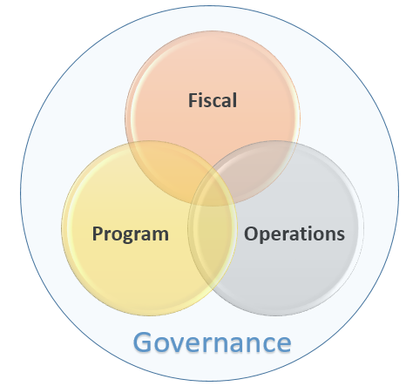

Slide 30
Key Executive Orders
Executive Order N-29-30: Brown Act- portions to suspend: Can meet virtually and outside of district/ boundaries; not required to post residence address; must provide and post on webpage virtual/ telephonic access; must follow 72 hour posting.
Latest Executive Order N-56-20: LCAP changes and “written report”:
LCAP December 15 extension.
Written report and budget approved and submitted July 1, 2020.
No public hearing required.
Written report submitted to authorizers and County Superintendent by July 1 (EDC 47604.33).
Written report posted on school’s homepage on the internet.
Notes:
This would be old news for most. Just a quick reminder on these.

Slide 31
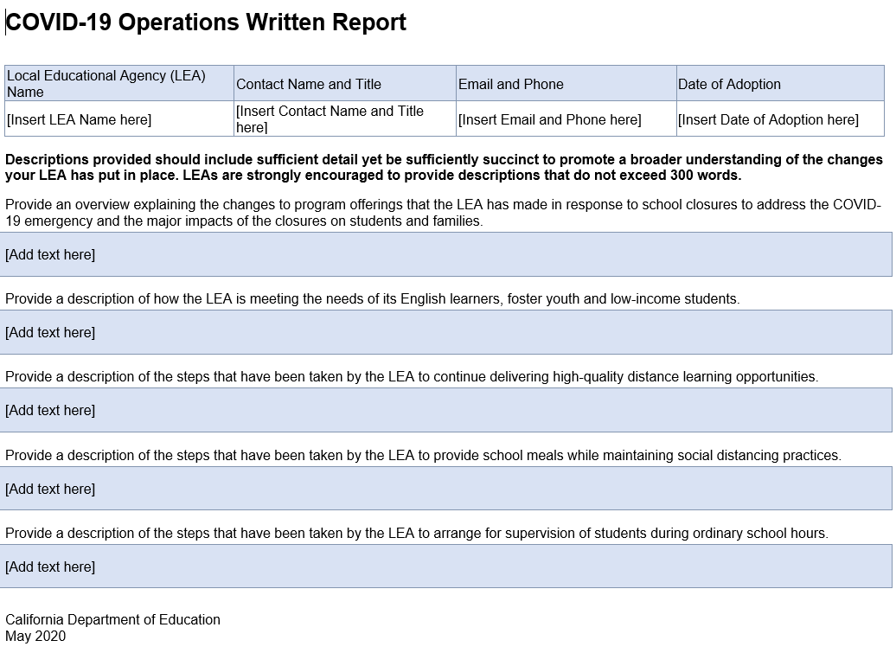

Slide 32
COVID-19 Legislation
AB 2019 Pupil instruction: College and Career Access Pathways partnerships.
AB 2052 Pupil instruction: instructional time requirements.
AB 2485 Teacher credentialing: subject matter competence.
AB 2990 Pupil instruction: educational enrichment activities - prohibit local educational agencies from offering any financial incentives for enrollment, referral, retention, or participation in an educational enrichment activity.

Slide 33
Fiscal Resources
CDE Estimated Cash Flow: https://www.cde.ca.gov/fg/aa/ca/estcashflow.asp
FCMAT Fiscal Alerts and COVID-19 Resources: https://www.fcmat.org/COVID-19-Resources
School Services of California Inc.:
https://www.sscal.com/
California Charter Authorizing Professionals:
https://calauthorizers.org/

Slide 34
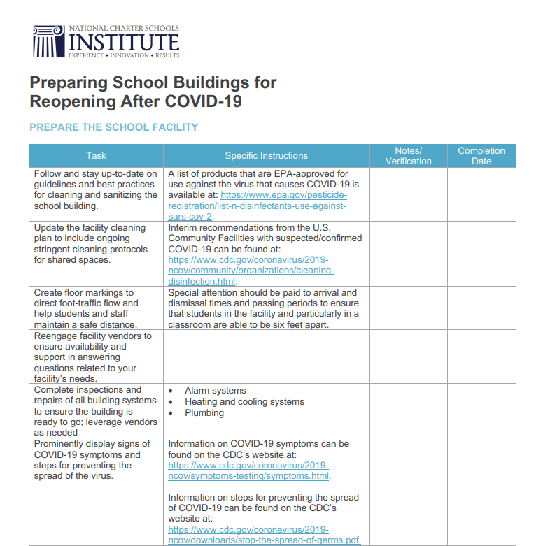
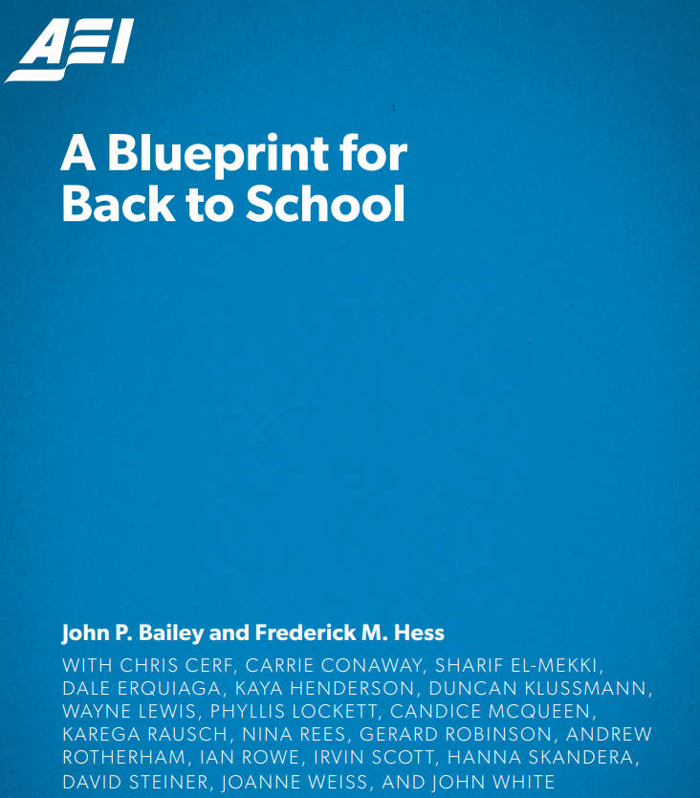
Reopening Resources
https://nationalcharterschools.org/
https://www.aei.org/wp-content/uploads/2020/05/A-Blueprint-for-Back-to-School.pdf

Slide 35
Notes:
Corey

Slide 36
Thank you!

