Slide 1
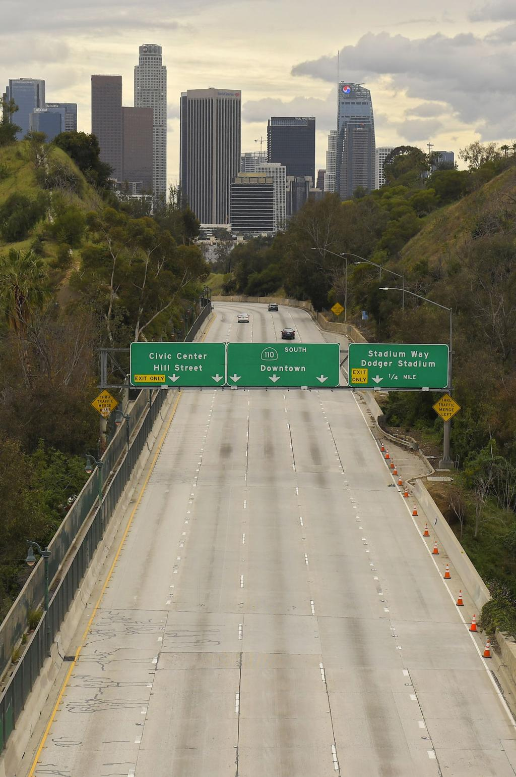
Small School Districts Association and California Charter Authorizing Professionals
Webinar Series
On the Other Side of COVID-19: Budget Forecasting & Cashflow Management for 2020-21 and Beyond
Notes:
Victor

Slide 2
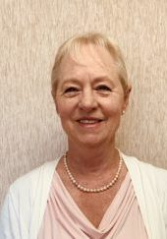
Speaker
Debi Deal,
CCAP Treasurer/
Fiscal Expert
ddeal@brightlake.com
Notes:
Corey- intros

Slide 3
For Today
Notes:
Corey

Slide 4
Take Away for Today
Fiscal Updates.
Wrapping up the 2019-20 school year.
Building up the reserves.
Bracing for 2020-21 and beyond.
Cash management will be the key going forward.

Slide 5
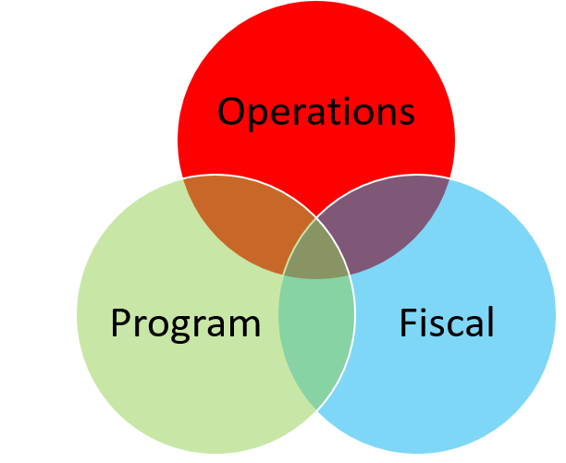
Overlapping Considertions

Slide 6
Governor’s Executive Orders
Executive Order N-26-20: Ensuring funding to support: 1) Deliver high-quality education opportunities; 2) Provide school meals; 3) Provide supervision; 4) Pay employees
Executive Order N-29-30: Brown Act- portions to suspend: Can meet virtually and outside of district/ boundaries; not required to post residence address; must provide and post on webpage virtual/ telephonic access; must follow 72 hour posting.
Executive Order N-30-20: Suspension of State assessments
NEW! Executive Order N-56-20: LCAP changes and “written report”:
1) LCAP December 15 extension;
2) Written report and budget approved and submitted July 1, 2020;
3) Written report submitted to authorizers and County Superintendent by July 1 (EDC 47604.33);
4) Written report posted on school’s homepage on the internet.

Slide 7
Composition of the State Budget
Sales Taxes
California State Budget
Personal Income Tax
Corporate Taxes

Slide 8
Volatility of the State Budget
When any one of these taxes drop, there are impacts to the state budget which impacts K-14.
When all three drop, we are in for a bumpy ride, so fasten your seat belts!
The downward trajectory is quick, recovery is slow, and the impact will be more difficult.
Notes:
Debi

Slide 9
Don’t Forget Your CDE Waivers
Federal Waivers and flexibility webinar and slides.
Waiver information CDE
Notes:
Ed

Slide 10
May Revise
Estimated Actuals for 2019-20
Cash Management
Additional Reductions
COLA?
State Lottery
and Local Revenue
Projected ADA
Deficits
and Deferrals

Slide 11
Fiscal Updates
Local Control & Accountability Plan/New Reporting Requirements
• Order extends deadline for an LEA to adopt 2020-21 LCAP from July 1 to Dec. 15, 2020 • County superintendents have until Jan. 14, 2021 to approve district LCAPs • Order waives requirements for LEA to adopt an LCAP before it can adopt its budget • LEA governing body now required to publish a report describing the programmatic changes made in response to COVID-19 emergency • Report must be adopted at same meeting at which governing body adopts 2020-21 budget • Report must describe how LEA is meeting needs of “unduplicated” students (low-income, English learners, foster youth) • Report must describe how LEA is delivering high-quality distance learning, providing non-congregate meals and arranging for student supervision during normal school hours • Report must be submitted with LEA’s adopted budget and posted on LEA’s website • Order waives requirement for 2020-21 LCAPs to use the new template adopted by the State Board in January • New LCAP template will be used for the first time in spring 2021 as part of the first year in a new 3-year LCAP cycle • Legislation will address specifics on modified LCAP process and template; CDE to release FAQ on executive order

Slide 12
Wrapping Up the Year
Book CARES ACT and SB 117 revenues
Calculate areas of savings: Substitute costs, overtime, extra time, NPA services, utility costs
Adjust for unusual costs: Custodial cleaning supplies, overtime for M&O
Build reserve levels – especially cash!
Plan for ZERO COLA – possibly negative COLA - for 2020-21 and 2021-22
Notes:
Debi

Slide 13
Cash is King, Credit is Better
Cash deferrals are a solution for the State to smooth out its own cash deficits.
Small school districts need to increase the cash portion of ending fund balance reserve levels – sooner than later!
Managing cash balances monthly is critical in maintaining fiscal solvency.

Slide 14
Guidelines for Authorizers to Charters
Consider :
Develop a unified message to all charter schools for budget assumptions.
Ensure charters know about the waivers and timelines.
Plan for an economic downturn.
Train charters on cash flow management.
Build communication – provide some flexibility.
Notes:
Debi

Slide 15
The Future
Budgeting for 2020-21 and beyond will involve MAJOR uncertainty. Assumptions will change as information is known.
Developing a baseline budget – just the basics and prepare multiple assumption models.
Adjust assumptions; plan for zero, or negative COLA and cash deferrals.
The new provision of the 2019-20 Budget Act:
K-12 Autofit Provision will most likely be implemented – allows the Director of Finance to “autofit” the LCFF COLA to “fit” the minimum guarantee.
Cash flow management will be critical for small school districts and charter schools
Build cash reserves as quickly as possible.
Notes:
Debi

Slide 16
Next Steps and Resources
Stay Tuned!
CCAP Library – full of resources, links and articles.
In case you missed - Cash-flow Training 4/27/20 webinar presentation and Excel spreadsheet.
Email (ddeal@brightlake.com or Debi.Deal@calauthorizers.org )
Notes:
Victor

Slide 17
Notes:
Corey

