Slide 1
California Charter Authorizing Professionals SB 820 Impacts on Charter Schools September 30, 2020

Slide 2
Zoom Functionality
Use the chat feature to ask questions during the presentation. CCAP team members will be monitoring the chat and your questions will be addressed at the appropriate time.
Please MUTE your microphone during the presentation
CHAT
TYPE HERE

Slide 3
About CCAP
Founded by a group of committed authorizers with a mission to advance quality public education for all students
National Dissemination Grant recipient from the U.S. Department of Education’s Office of Innovation to improve charter school authorizing best practices, partnering with Colorado and Florida in the Tri-State Alliance for Improving District-led Authorizing
Notes:
Victor

Slide 4
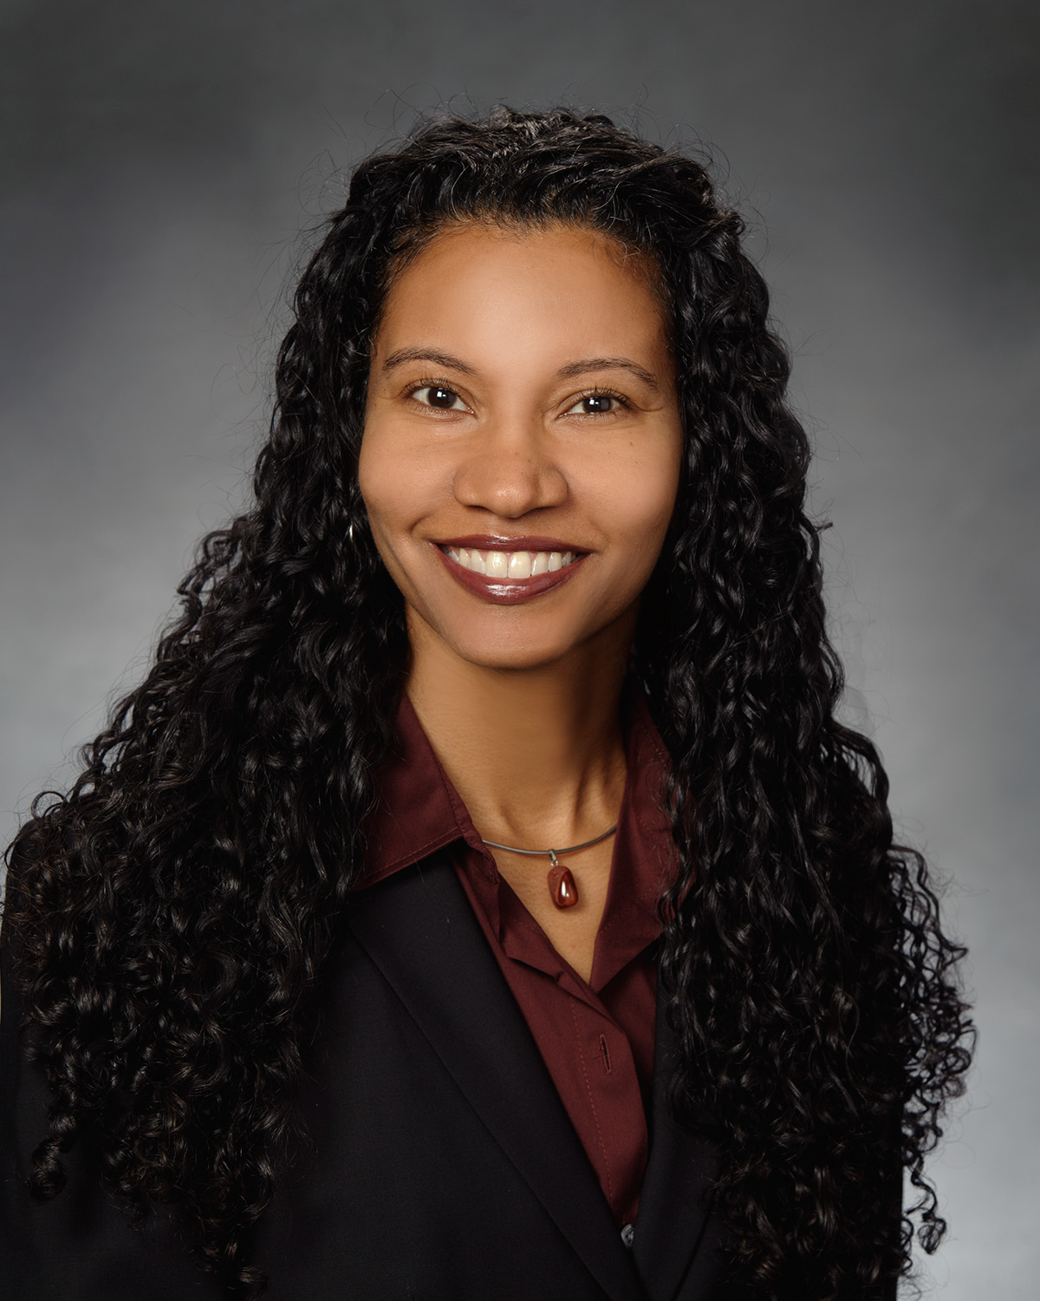
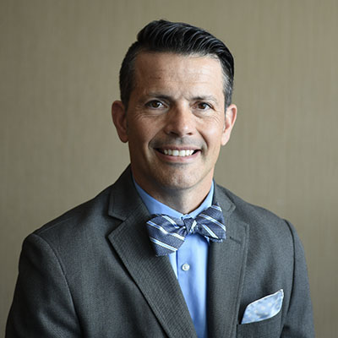
Speakers
Brianna García
Director, Management Consulting Services
School Services of California Inc.
CCAP Board Member
Dr. Corey Loomis,
Charter Schools Unit Director
Riverside County Office of Education
CCAP Vice President
Notes:
Corey- intros

Slide 5
Senate Bill 820
Senate Bill (SB) 820 (Chapter 110/2020) is the education budget cleanup trailer bill
Makes changes to the education provisions in the 2020–21 State Budget
As it relates to charter schools, SB 820 includes numerous provisions that either exclusively affect charter schools or affect them in a slightly different way than other local educational agencies (LEAs)

Slide 6
What the Budget Brought
The 2020–21 Adopted State Budget brought both good and bad news for education
While the anticipated cuts did not materialize, the coming deferrals might make some second guess whether that was a good strategy
ADA¹ Hold Harmless
Deferrals
For 2020–21, local educational agencies (LEAs) will be funded based on 2019–20 ADA
$12 billion in cash and budget deferrals
¹Average daily attendance

Slide 7
2020–21 ADA Hold Harmless
ADA for 2019–20 is determined using P-2¹ ADA from July 1, 2019, to February 29, 2020
As ADA is not being reported for 2020–21, prior-year ADA for 2021–22 will also be 2019–20 P-2 ADA
While the 2020–21 ADA hold harmless provisions also provide protection for charter schools, charter schools are not covered by the statutory prior-year/current-year protections afforded to school districts
2019–20
ADA
2020–21
ADA
2021–22
ADA
For apportionment purposes, 2020–21 ADA will be determined based on the 2019–20 P-2 ADA
¹Second Principal Apportionment

Slide 8
Newly Operational Charter Schools
ADA will be determined by:
Certified enrollment as of Census Day, October 7, 2020, reduced by the statewide average absence rates for appropriate grade spans
Charter schools must have begun instruction in 2020–21 and must have been either:
Will receive advance funding per Education Code (EC §) 47652 for July 2020 through January 2021 and be subject to the same deferrals as other LEAs for February through June 2021
Authorized by a school district or county office of education (COE) before June 30, 2020
Approved by the State Board of Education at its July 8 and 9, 2020, meeting

Slide 9
Nonclassroom-based Charter School Funding
Nonclassroom-based charter schools are subject to a funding determination process to calculate their funding amounts
Funding determinations that expire on June 30, 2021, or June 30, 2022, will receive their current funding for two years upon submission of a complete funding determination request no later than June 30, 2021, or June 30, 2022, as applicable
Late submissions will receive 85% funding for two fiscal years

Slide 10
Growth Funding
SB 820 provides growth funding for LEAs
Though it only does so for LEAs that projected enrollment or ADA growth in their 2019–20 Second Interim report or in their 2020–21 budget that was adopted by June 30, 2020
No growth funding is provided for nonclassroom-based charter schools

Slide 11
Growth Funding
ADA growth included in the LEA budget, or the enrollment growth included in the LEA budget reduced by the statewide average absence rate for the appropriate grade levels
Funding is provided based on the lesser of:
Actual enrollment growth as of Census Day, October 7, 2020, reduced by the statewide average absence rate for the appropriate grade levels (to arrive at a measure of ADA)
11

Slide 12
Growth Funding—Lottery
If a charter school has more students enrolled than is sustainable given the fiscal impact of the lack of or limited growth funding
It must conduct a public random drawing in order to determine which students will remain enrolled in the charter school for the
2020–21 school year
This applies to new students only—existing students should not be included in the lottery
12

Slide 13
Growth Funding
If a charter school ceased operation during or after 2019–20 school year and is not providing instruction in the 2020–21 school year, the sponsoring LEA (as defined in EC § 47635[i]) absorbs the ADA of the former charter school
SB 98 (Chapter 24/2020) included new charter definitions as a result of changes enacted by Assembly Bill (AB) 1507 (Chapter 487/2019)
SB 820 includes language for how ADA will be allocated for divided charter schools
Total ADA attributable to the restructured and remaining portions of a divided charter school cannot exceed the total ADA of the original charter school for the 2019–20 fiscal year
This calculated ADA will be used for any calculation for the affected charter schools that require the use of ADA

Slide 14
Certificated Employees
AB 1505 (Chapter 486/2019) added a requirement that all teachers employed by charter schools be credentialed by July 1, 2020
However, if they were already employed by a charter school during the 2019–20 school year, they have until July 1, 2025, to obtain their certification
SB 820 clarifies that as it pertains to distance learning, the flexibility provided to teachers employed by charter schools during the 2019–20 school year applies
Distance learning requires instruction be provided under the immediate supervision of a certificated employee
Therefore, teachers employed by a charter school during the 2019–20, while not yet certificated, can provide instruction as part of distance learning

Slide 15
Rescission Notification
01
SB 98 allowed charter schools to delay adding grade levels as noted in their charter petition for the 2020–21
02
SB 820 allows for the rescission of this notice
No later than September 30, 2020, the charter school must notify its chartering authority, the CDE, and the parents or guardians of students—who indicated their intent to enroll in the charter school or affected grade level—of the charter school’s decision to rescind
03

Slide 16
School Plan for Student Achievement
01
LEAs are required to complete a School Plan for Student Achievement (SPSA)
02
Single-school districts and charter schools can use their Local Control and Accountability Plan (LCAP) to serve as the SPSA, provided certain requirements are met
As LEAs are not required to adopt a 2020–21 LCAP, single-school districts and charter schools are required to complete an SPSA for 2020–21 in addition to their Learning Continuity and Attendance Plan
03
04
The stakeholder process used for the Learning Continuity and Attendance Plan must also be used for adoption of the SPSA

Slide 17
Q&A

Slide 18
Thank You
Brianna García
Director, Management Consulting Services
briannag@sscal.com

