Slide 1
CA2.0 - Advancing Equity and Access Through Quality Authorizing
Notes:
Steve

Slide 2
CA 2.0-Advancing Equity and Access Through Quality Authorizing
Notes:
Steve

Slide 3
Putting it all together: The Annual Performance Report
Purpose
Convey the charter school’s annual performance and performance trend over time
Assess the charter school’s performance in light of renewal
Initiate a conversation with charter school, differentiate oversight, install a plan if necessary
Grounded by the Four Core Performance Questions
Including, Is the charter school advancing equity and access through serving public policy purposes?

Slide 4
Putting it all together: The Annual Performance Report
Format
Annotated and Template
Introduction to frame the report
Primary audience is assumed to be authorizer board
Provide a summary of performance with attached detail
Annual Performance Report: Ingredients
Summary of school and school performance
Academic, Operations, and Financial
Inclusion of non-rated narrative addressing the fourth Core Performance Question
LCAP summary and overall Strengths/Areas for Improvement
Detailed attachments include
Completed Academic, Operations and Governance, and Financial Health frameworks
Site visit report

Slide 5
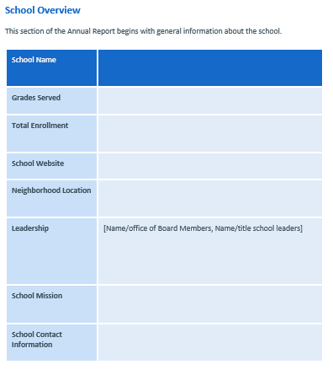
The Annual Performance Report: Sections
Opens with an introduction and overview of the charter school

Slide 6
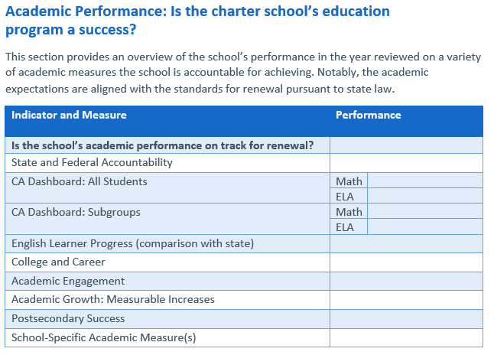
The Annual Performance Report: Academic
Summary of performance (Template) and Example (note the use of CA Dashboard color)

Slide 7
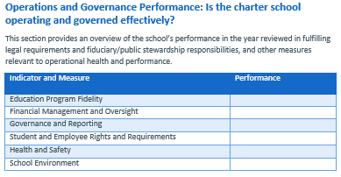
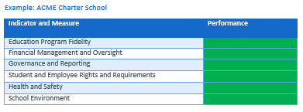
The Annual Performance Report: Operations
Summary of performance (Template) and Example from Annotated Template

Slide 8
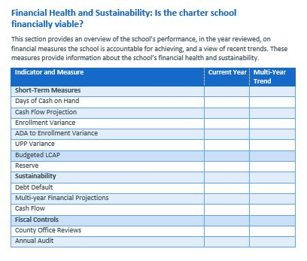
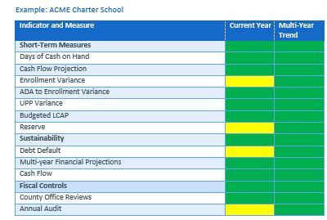
The Annual Performance Report: Financial
Summary of performance (Template) and Example from Annotated Template

Slide 9
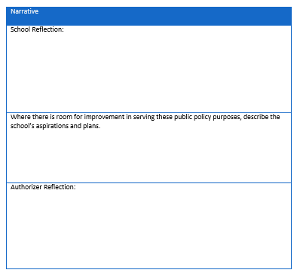
The Annual Performance Report: Equity and Access
Informational section of the Report. For school and authorizer to reflect and provide a narrative summary.

Slide 10
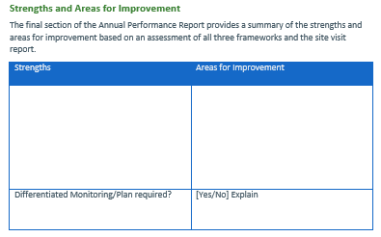
The Annual Performance Report: Strengths and Areas for Improvement, Action
Final summary outlining positive and areas in need of attention.
Based on performance will the authorizer require action? For example, initiate a differentiated monitoring plan or intervention ladder or require a plan from the school?

Slide 11
CCAP is here to support you! Questions: info@calauthorizers.org

Slide 12
CA 2.0-Advancing Equity and Access Through Quality Authorizing
Notes:
Steve

