Slide 1
CA2.0 - Advancing Equity and Access Through Quality Authorizing
Notes:
Steve

Slide 2
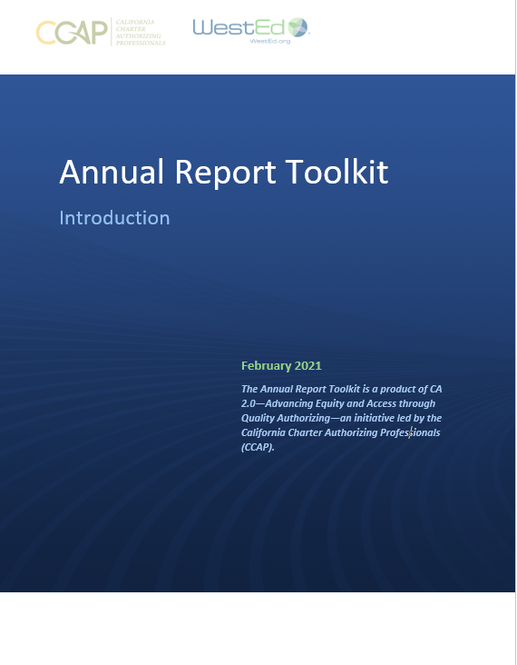
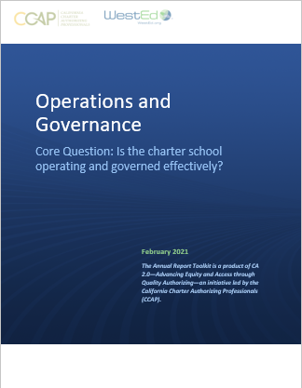
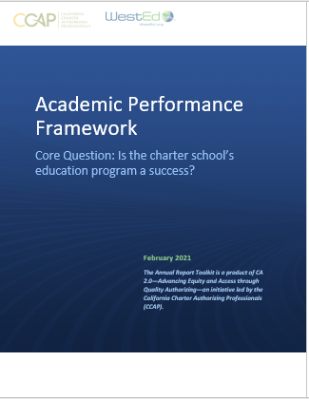
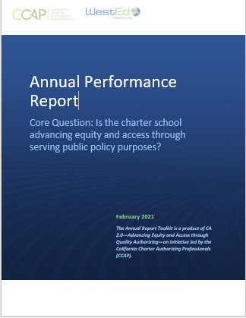
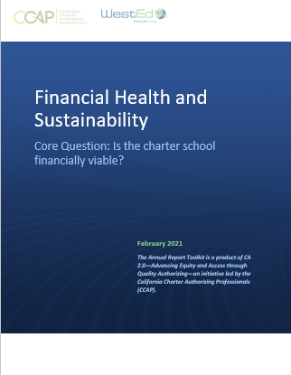
CA 2.0-Advancing Equity and Access Through Quality Authorizing
Notes:
Steve

Slide 3
Is the charter school’s education program a success?
Introductory language
Definitions
Template
Explanations
Examples
Template for you to use/customize

Slide 4
Is the charter school’s education program a success?
Introduction
Baseline to institute performance-based accountability for demonstrable pupil outcomes.
Academic Framework is aligned with the state accountability system and the standards for renewal within the recently revised California Education Code (pursuant to Assembly Bill 1505).
Use
Academic + Finance + Operational Frameworks used annually to assess performance
Cumulative record across years
Basis for honest and supportive conversations with schools

Slide 5
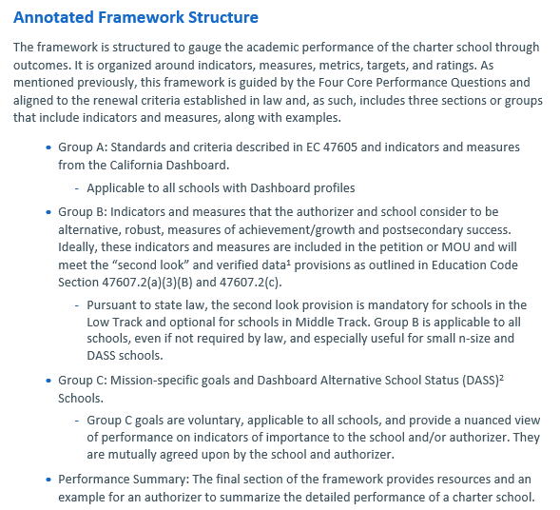
Is the charter school’s education program a success?
Alignment and Implications
Aligned to renewal criteria
Group A: State
Group B: “second look” verified data
DASS, small n-size
Group C: Mission
DASS, small n-size

Slide 6
Is the charter school’s education program a success?
Group A: State Dashboard
Measure 1x: Insert Measure Here
Measure 1b: English Language Arts
Group | Points Below Standard and Rating (color) | Comparison with State Average (Above, At, Below)
All Students | -4.8 | Below (State -2.5)
English Learners | N/A
Students with Disabilities
Homeless
Foster Youth
Socioeconomically Disadvantaged | -12 | Above (State -30.1)
American Indian | N/A
Asian
African American
Filipino
Hispanic | -12.5 | Above (State -26.6)
Pacific Islander | N/A
Two or More Races
White | -19.1 | Below (State +30.7)
Group | Points Below Standard and Rating (Red, Orange, Yellow, Green, Blue) | Comparison with State Average (Above, At, Below)
All Students
English Learners
Students with Disabilities
Homeless
Foster Youth
Socioeconomically Disadvantaged
American Indian
Asian
African American
Filipino
Hispanic
Pacific Islander
Two or More Races
White

Slide 7
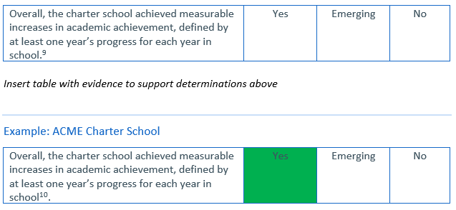
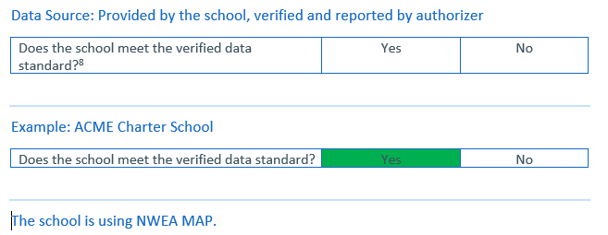
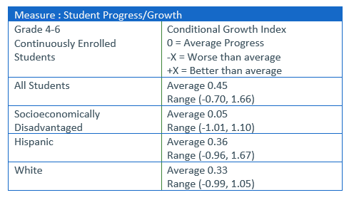
Is the charter school’s education program a success?
Group B: Beyond the State Dashboard, Academic Growth and Verified Data

Slide 8
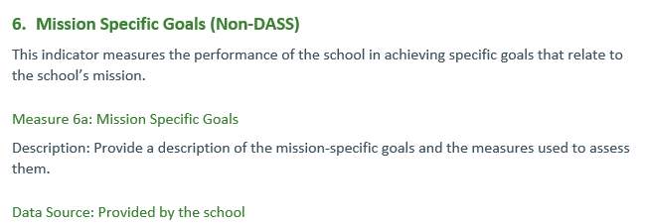
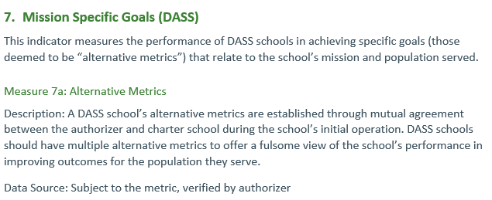
Is the charter school’s education program a success?
Group C: Mission Specific (Authorizer and School Agreed Upon)

Slide 9
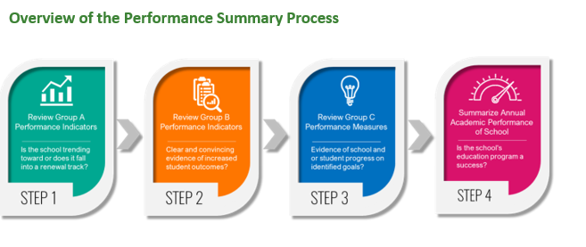
Is the charter school’s education program a success?
Performance Summary

Slide 10
CCAP is here to support you! Questions: info@calauthorizers.org

Slide 11
CA 2.0-Advancing Equity and Access Through Quality Authorizing
Notes:
Steve

