Slide 1
CA2.0 - Advancing Equity and Access Through Quality Authorizing
Notes:
Steve

Slide 2
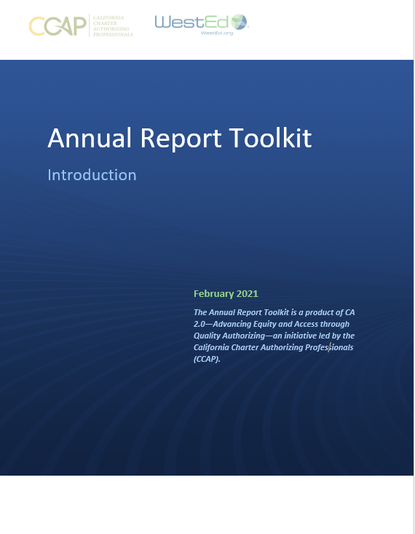
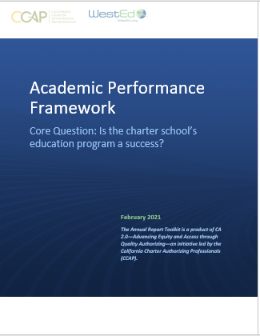
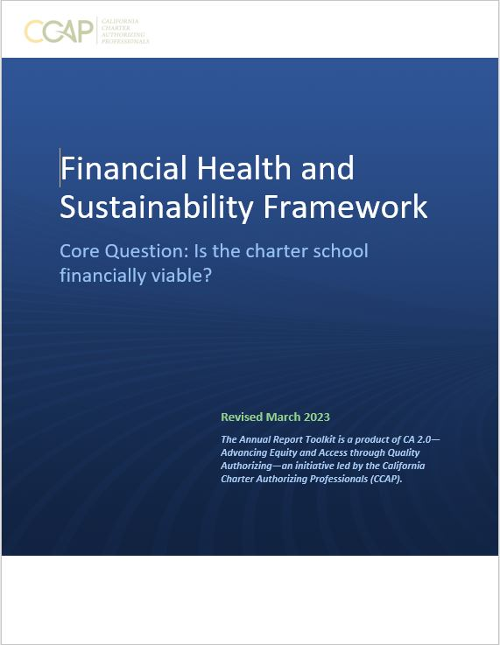
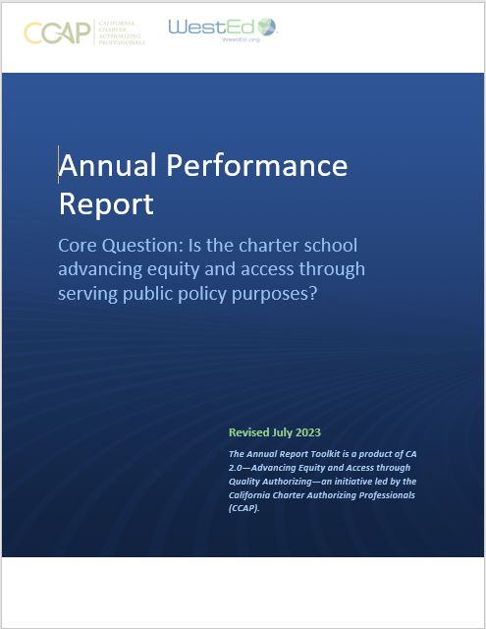
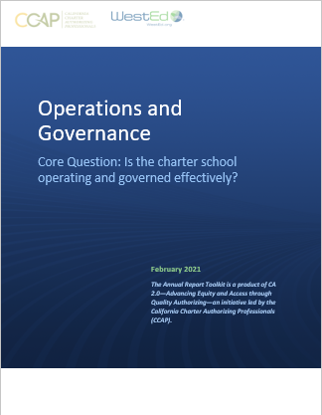
CA 2.0-Advancing Equity and Access Through Quality Authorizing
Notes:
Steve

Slide 3
Is the charter school financially viable?
Introductory language
Definitions
Explanations
Examples
Template for you to use/customize

Slide 4
Is the charter school financially viable?
Introduction
Fulfills obligation to monitor the fiscal condition of each charter school
Evaluates near-term health and long-term sustainability
Not compliance matters (found in Operational and Governance Framework)
Focuses on financial data found in audited financials
Indicators and measures reflect best practices
Use
Academic + Finance + Operational Frameworks used annually to assess performance
Tool to engage in conversations regarding fiscal position and school planning

Slide 5
Is the charter school financially viable?
Short-Term
Days of Cash on Hand “How many days of cash on hand does the school have to pay its bills?”
Cash Flow Projection “Will cash received meet obligations each month of the budgeted fiscal year?”
Enrollment Variance “Does the projected student enrollment support the budgeted revenue?”
Average Daily Attendance (ADA) to Enrollment Variance “Is the projected funded ADA used for budgeted revenue reasonable?”
Unduplicated Pupil Percentage (UPP) Variance “Does the school’s actual UPP funding support the operating budget?”
Budgeted Local Control and Accountability Plan (LCAP) “Is the school budgeting items that mirror the approved LCAP plan and is the school’s spending so far materially consistent with the budget?”
Reserve for Economic Uncertainty “Does the school have the resources to weather economic uncertainties?”
Sustainability
Debt Default “Is the school meeting its debt obligations?”
Multi-Year Financial Projections “Is the school living within its means?”
Subsequent Years Cash Flow “How much money does the school have available to spend?”
Fiscal Controls
County Office of Education Financial Reviews “Is the Board receiving copies of the COE letters regarding their review of the submitted financial reports?”
Annual Independent Audit “Did the auditors provide an unqualified opinion?”

Slide 6
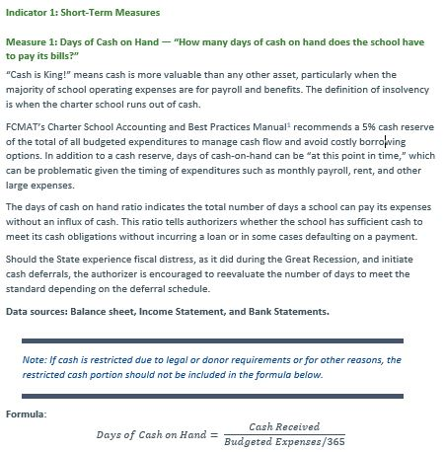
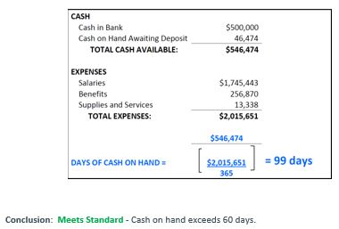
Is the charter school financially viable?
Annotated framework provides information and an example.

Slide 7
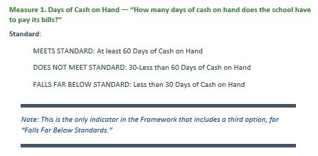
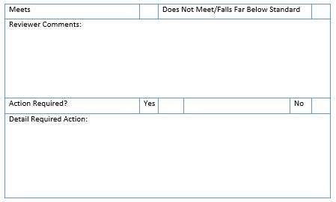
Is the charter school financially viable?
Indicator, measure, and targets
Authorizer assesses and completes

Slide 8
CCAP is here to support you! Questions: info@calauthorizers.org

Slide 9
CA 2.0-Advancing Equity and Access Through Quality Authorizing
Notes:
Steve

