Slide 1
CA2.0 - Advancing Equity and Access Through Quality Authorizing
Notes:
Steve

Slide 2
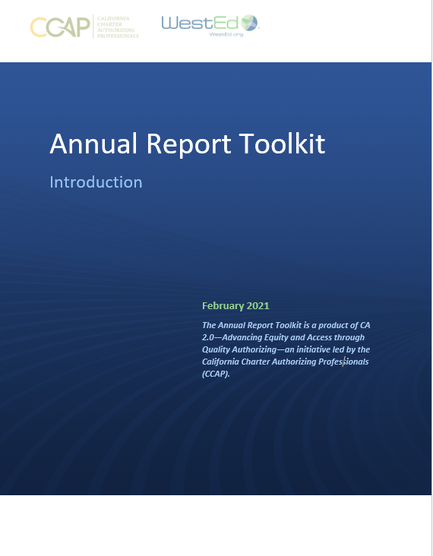
CA 2.0-Advancing Equity and Access Through Quality Authorizing
Notes:
Steve

Slide 3
CA 2.0-Advancing Equity and Access Through Quality Authorizing
Toolkits are intended as a foundation and resource for authorizers
Authorizers will need to adjust to their own contexts and practices
Toolkits incorporate legal requirements as well as best and promising practices
Toolkits focus on equity and access; particular focus on English learners
Notes:
Robin

Slide 4
Annual Performance Report: Introduction
Aligned to the criteria for renewal and the renewal review process;
Provides an indicator of the likelihood of the school’s ability to make a compelling case for renewal; and
Provides schools with regular feedback regarding their progress towards renewal and affords them an occasion to take early corrective action, thereby increasing the opportunities for a charter school to succeed.

Slide 5
Overview

Slide 6
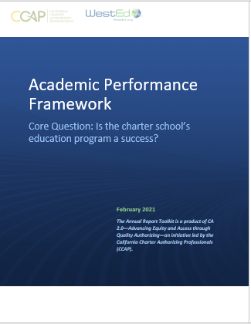
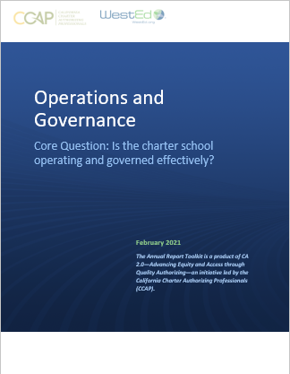
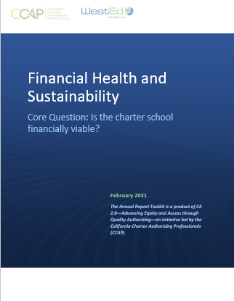
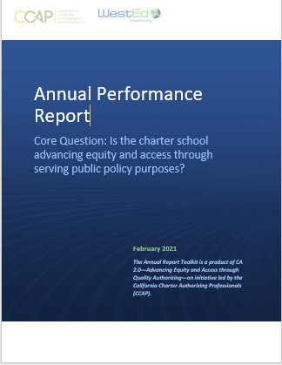
CA 2.0-Advancing Equity and Access Through Quality Authorizing
Notes:
Steve

Slide 7
CCAP is here to support you! Questions: info@calauthorizers.org

Slide 8
Thank you!

