Slide 1
CA2.0 - Advancing Equity and Access Through Quality Authorizing
Notes:
Steve

Slide 2
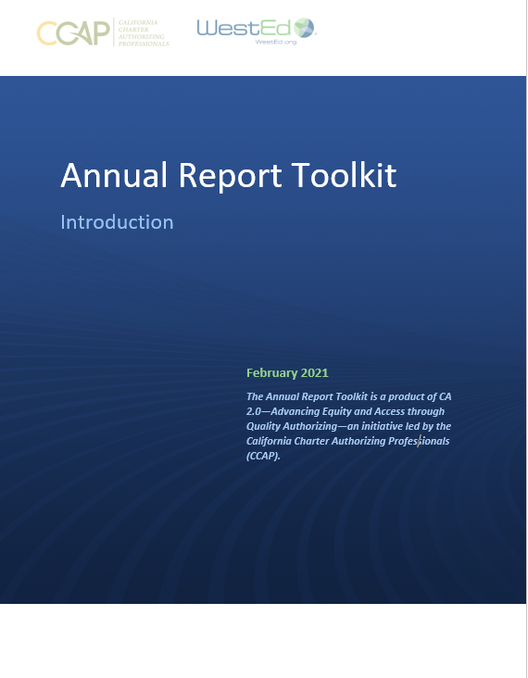
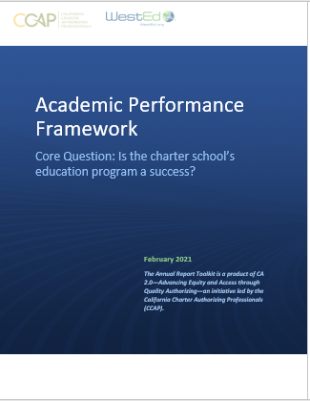
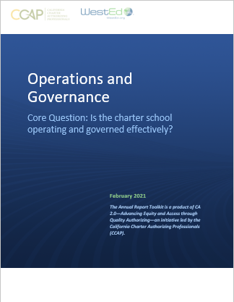
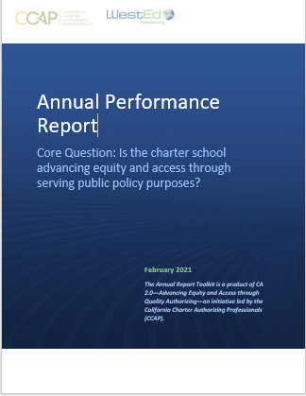
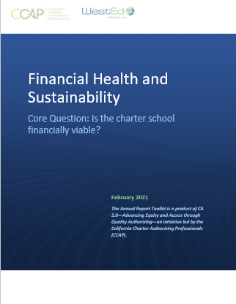
CA 2.0-Advancing Equity and Access Through Quality Authorizing
Notes:
Steve

Slide 3
Is the charter school operating and governed effectively?
Introductory language
Definitions
Explanations
Examples
Template for you to use/customize

Slide 4
Is the charter school operating and governed effectively?
Introduction
Measures compliance with legal and ethical standards
Evaluates compliance with requirements and processes
Academic and Financial evaluate outcomes
Represents a balance between protecting public interest and burdensome oversight
Use
Academic + Finance + Operational Frameworks used annually to assess performance
Cumulative record across years
Basis for honest and supportive conversations with schools

Slide 5
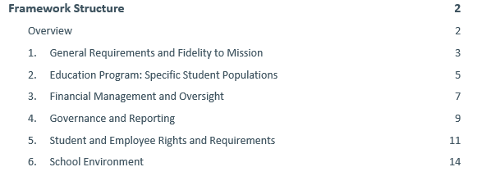
Is the charter school operating and governed effectively?
Alignment and Implications
Aligned to legal and ethical standards
Adaptable
Additional measures included for consideration
Focus on equity and access

Slide 6
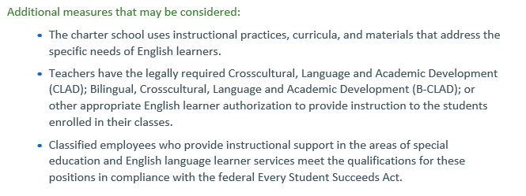
Is the charter school operating and governed effectively?

Slide 7
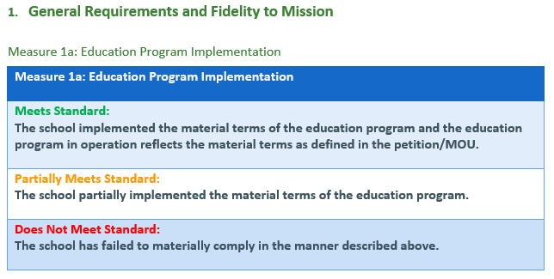
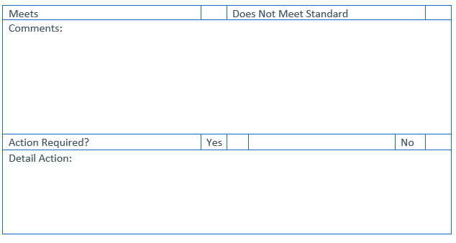
Is the charter school operating and governed effectively?
Indicator and measure
Authorizer assesses and completes

Slide 8
CCAP is here to support you! Questions: info@calauthorizers.org

Slide 9
CA 2.0-Advancing Equity and Access Through Quality Authorizing
Notes:
Steve

