Slide 1
CA2.0 - Advancing Equity and Access Through Quality Authorizing
February 2021
Notes:
Steve

Slide 2
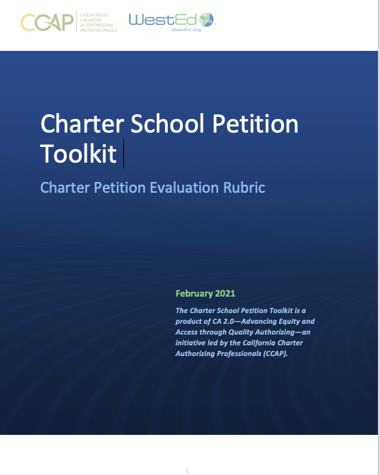
Charter School Petition Toolkit- Evaluation Rubric
Notes:
Robin

Slide 3
Evaluation Rubric: Purpose and Use
A rubric for authorizers and reviewers to use in evaluating the responses to 15 or 16 charter elements
Includes criteria or “look fors” for each element
Approach to review includes assurances, evidence of compliance, and quality indicators
Notes:
Robin

Slide 4
Evaluation Rubric: Petition Review Approach
Broad Goal: Maximize review time on high priority components.
Assurance: The authorizer accepts the petitioner's assurance that the element is complete/compliant, will be complete/compliant, or the school will operate within compliance.
Compliance: The authorizer evaluates these elements based on the existence of a response and whether the response is complete. Fundamental question: Did the petitioner provide what the authorizer asked?
Quality: The authorizer uses professional discretion to assess the quality of a response. The authorizer may guide their quality review by referencing best practices, evidence, or other generally accepted tools.
Notes:
Robin

Slide 5
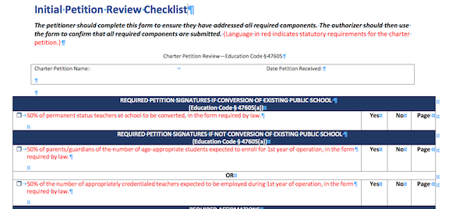
Evaluation Rubric: Petition Checklist
Includes an initial petition review checklist
Used by both the petitioner and authorizer to confirm all required components are included
Notes:
Robin

Slide 6
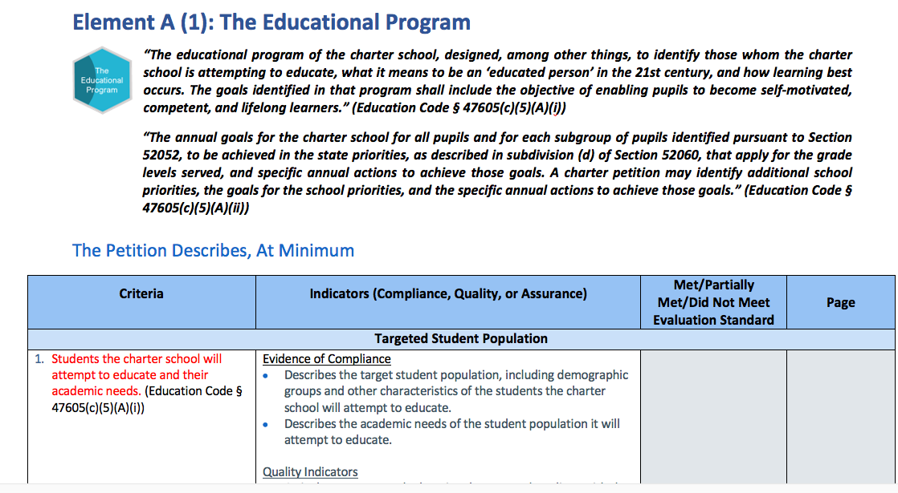
Petition Review Toolkit Components
Each element includes text from the statute and the citation
Criteria that are legally required to be in the petition are in red font
Reviewers should indicate whether the criteria are met, partially met, or not met and indicate the page number
Notes:
Robin

Slide 7
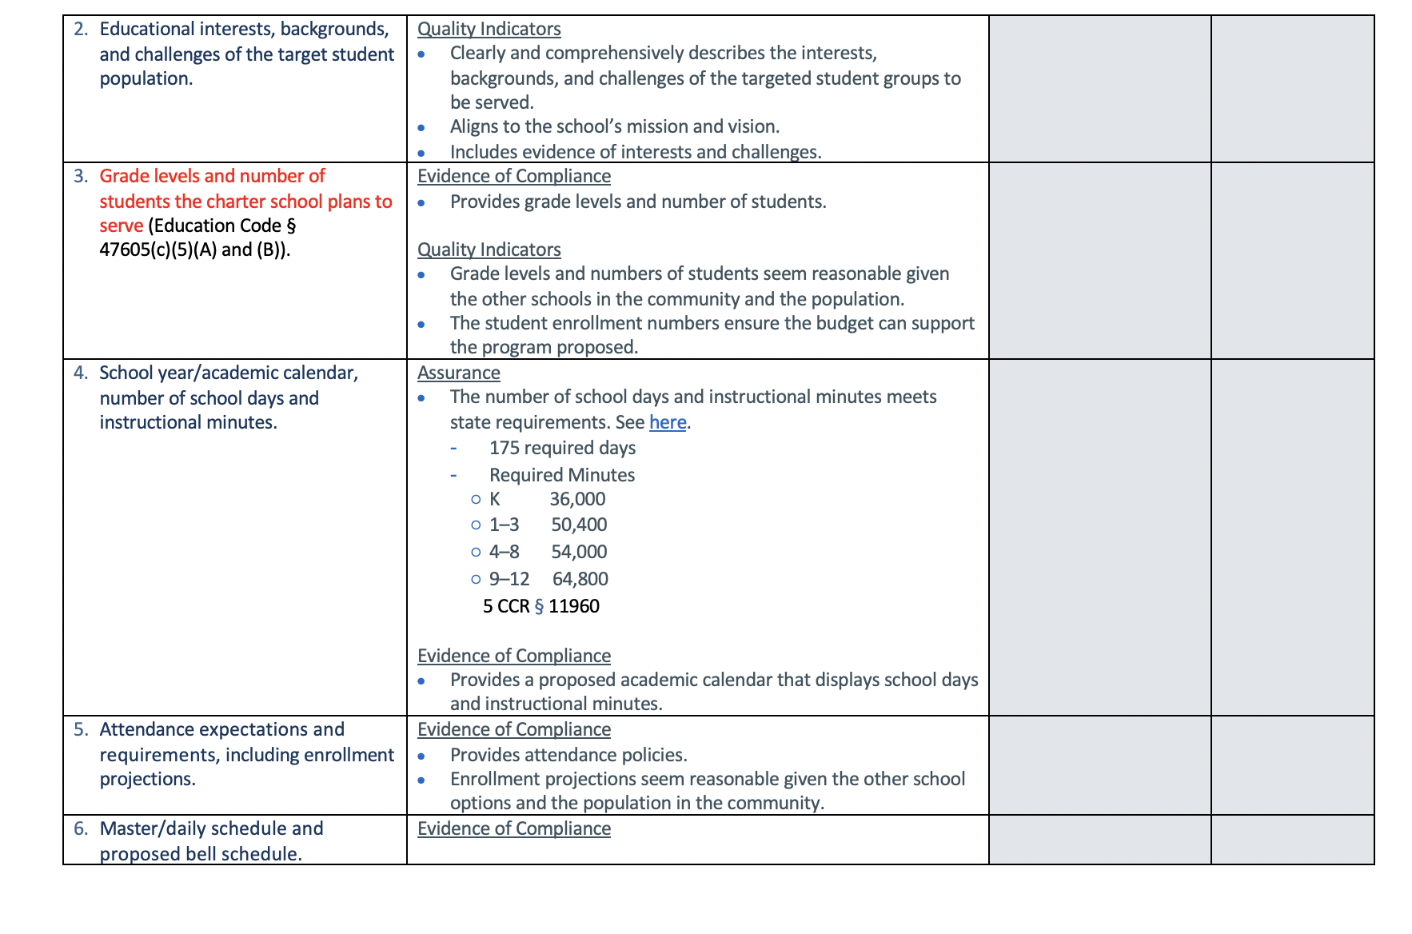
Notes:
Robin

Slide 8
Charter School Petition Toolkit- Evaluation Rubric
Notes:
Robin

