Slide 1
CA2.0 - Advancing Equity and Access Through Quality Authorizing
February 2021
Notes:
Steve

Slide 2
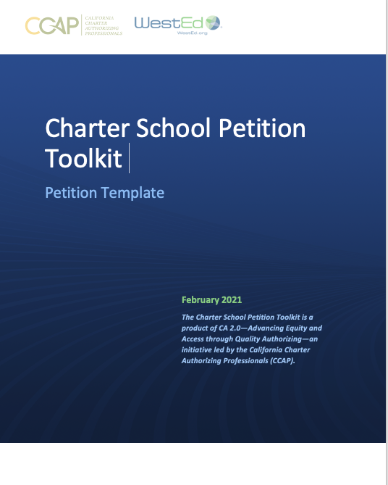
Charter School Petition Toolkit: Petition Template
Notes:
Robin

Slide 3
Petition Template: Purpose and Use
Provide a structure to guide petitioners in writing high-quality, legally compliant petitions
Authorizers can use it to communicate clear expectations about the content and format of the petition
Using a template helps to minimize submission of incomplete petitions
Notes:
Robin

Slide 4
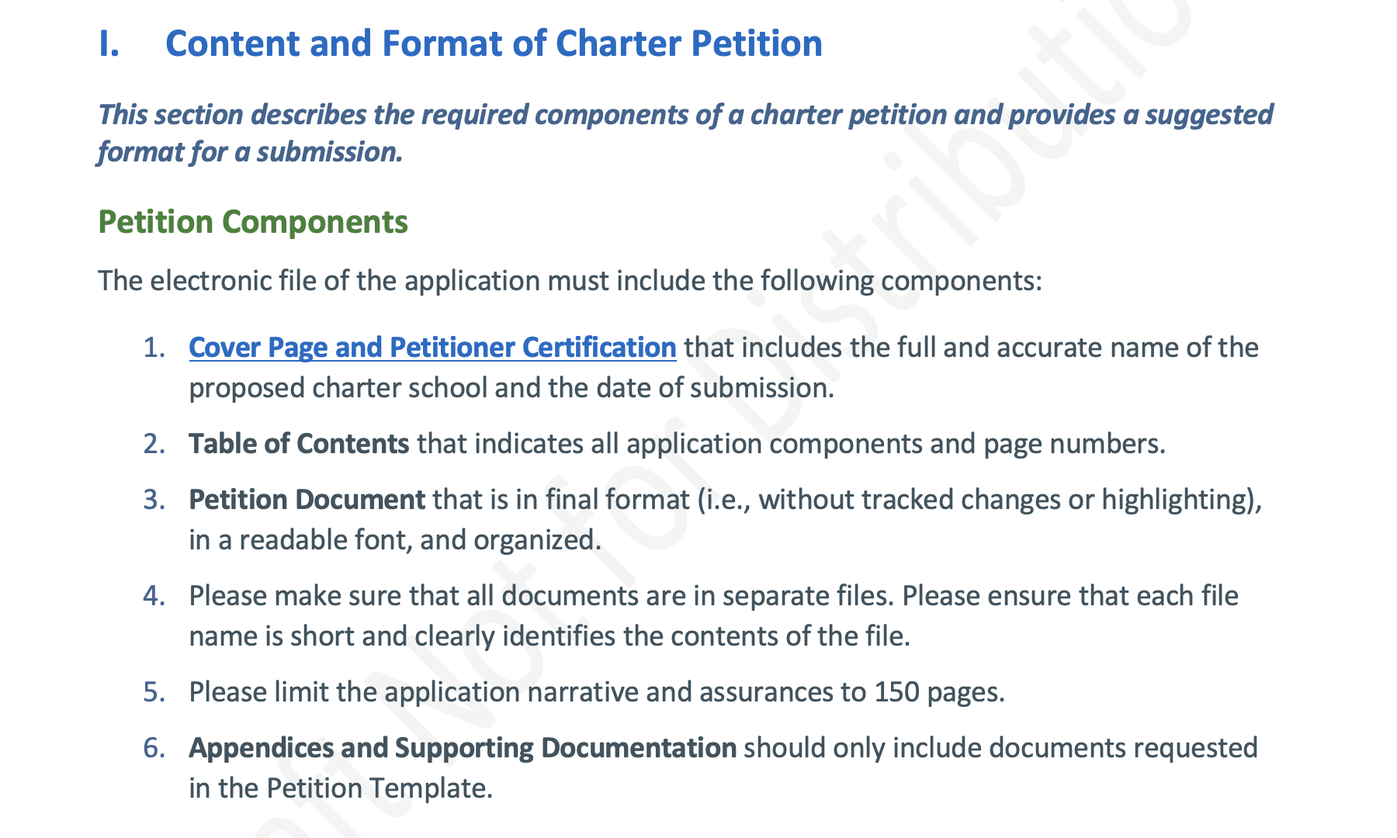
Petition Template: Format
Provides guidance on both content and format
Format instructions make the petition documents easier to review
Includes a template for a cover page and petitioner certification
Notes:
Robin

Slide 5
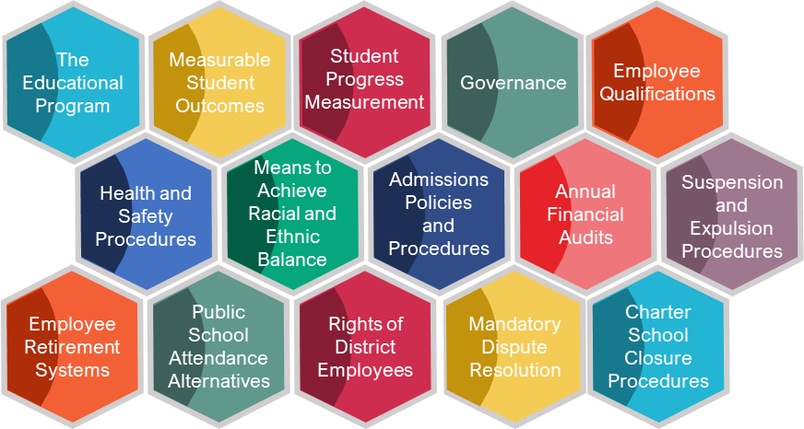
Petition Template:15 Charter Elements
Asks petitioners to address specific criteria within each of the 15 or 16 elements
Criteria include both statutory requirements and information needed for a robust petition
Notes:
Robin

Slide 6
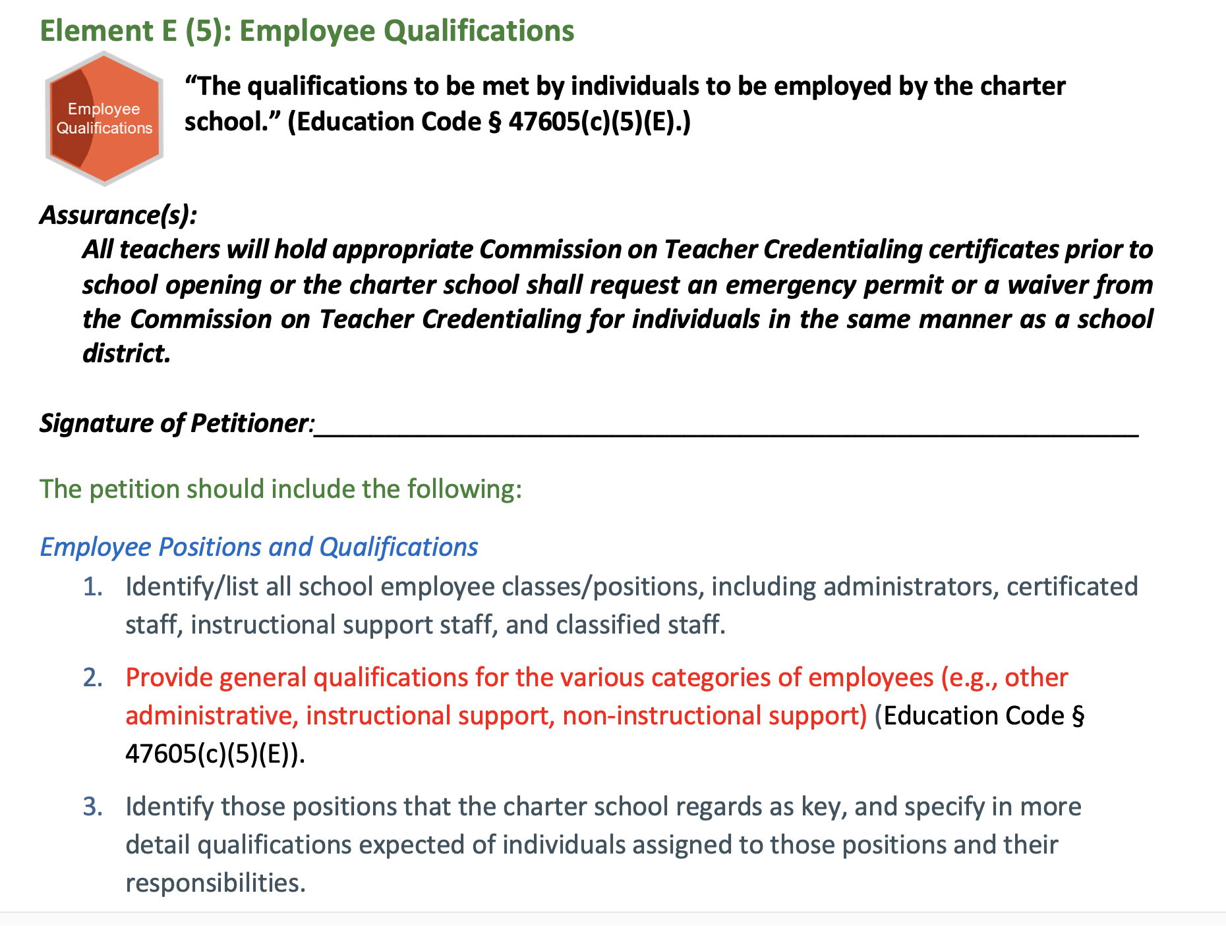
Petition Template: Sample Element
Each element includes text from the statute and the citation
Legally required items are in red font
Notes:
Robin

Slide 7
Petition Template: Supplemental Criteria
Also includes supplemental criteria
Notes:
Robin

Slide 8
Charter School Petition Toolkit: Petition Template
Notes:
Robin

