Slide 1
CA2.0 - Advancing Equity and Access Through Quality Authorizing
Notes:
Steve

Slide 2
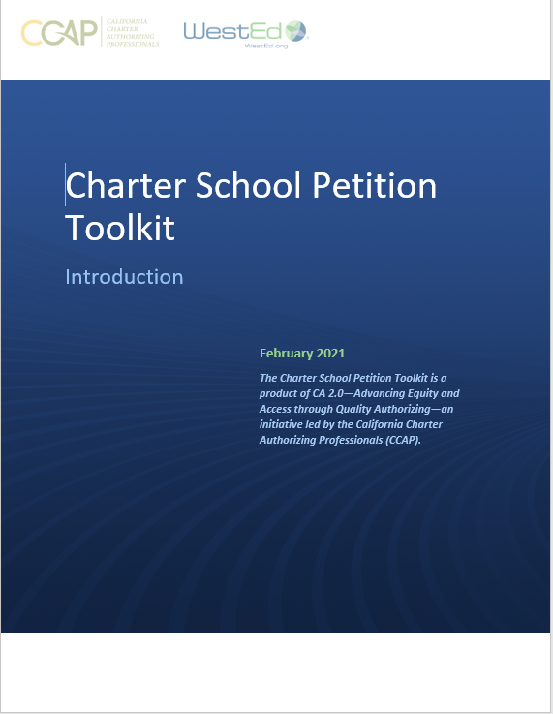
CA 2.0-Advancing Equity and Access Through Quality Authorizing
Notes:
Steve

Slide 3
CA 2.0-Advancing Equity and Access Through Quality Authorizing
Toolkits are intended as a foundation and resource for district and county authorizers
Authorizers will need to adjust to their own contexts and practices
Toolkits incorporate legal requirements as well as best and promising practices
Both toolkits focus on equity and access; the petition toolkit in particular includes a focus on English learners
Notes:
Robin

Slide 4
Petition Toolkit Components
Overview of the Petition Review Process
A guidance document for authorizers
Explains each step of a recommended petition submission and review process
Includes both legally required components and best practices
Petition Template
A template to guide petitioners in completing a high quality and legally compliant petition
Provides guidance and key questions petitioners should address

Slide 5
Petition Toolkit Components
Charter Petition Evaluation Rubric
Supports authorizers in evaluating the 15 or 16 elements of a charter petition
Includes criteria or “look fors” for each element
Findings of Fact Document
Template for authorizers to report on findings from the petition review
Aligned with the legal standard for review

Slide 6
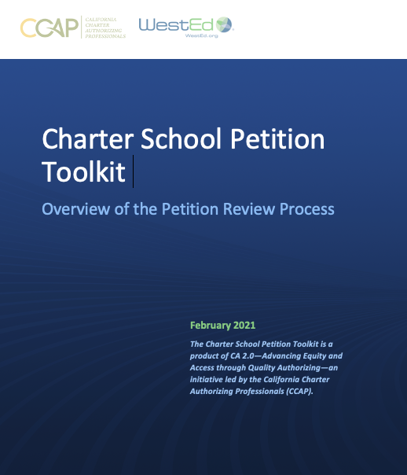
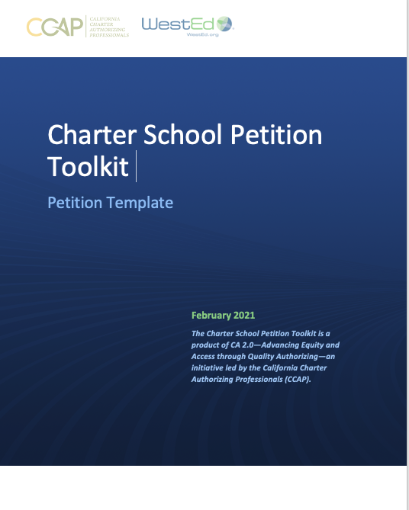
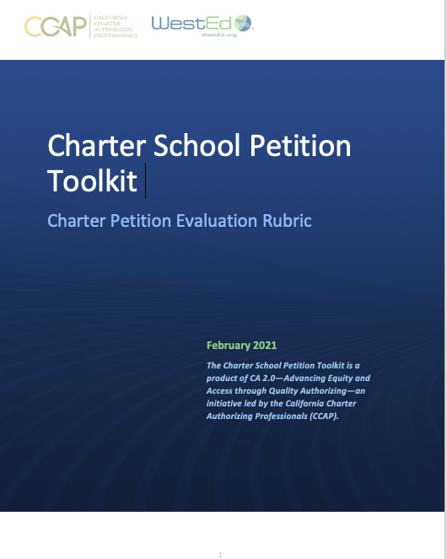
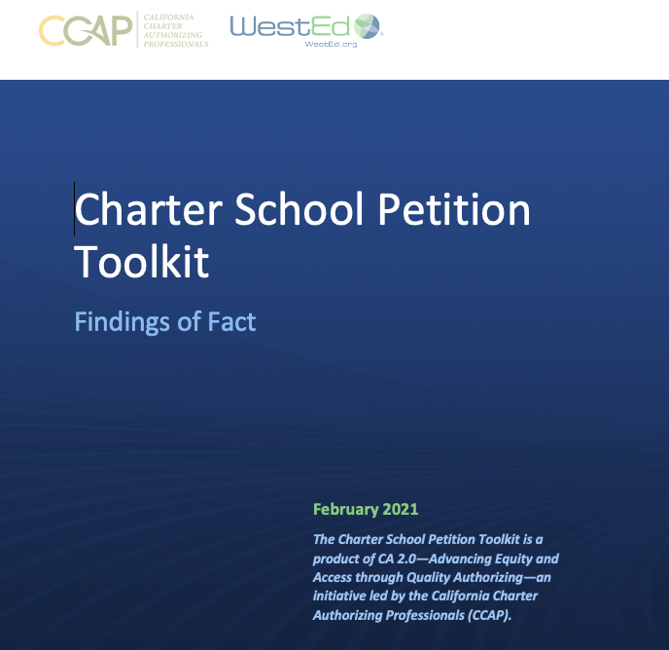
CA 2.0-Advancing Equity and Access Through Quality Authorizing
Notes:
Steve

Slide 7
CCAP is here to support you! Questions: info@calauthorizers.org

Slide 8
Thank you!

