Slide 1
California Charter Schools Oversight 201
For Experienced Board Members
LEAD WITH CONFIDENCE
County Board Governance Workshop
March 23, 2021
8:30 – 11:00 AM

Slide 2
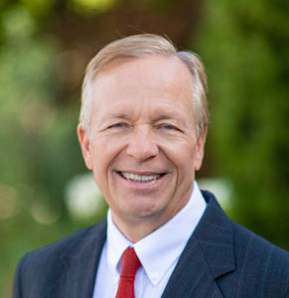
Today Presenters
Dr. Stacey Adler
Mono County
Superintendent of School
Dr. David Patterson
President, CCAP
Placer County Board of Education Trustee
Notes:
Corey- intros

Slide 3
California Charter Authorizing Professionals (CCAP)
Mono County
Located in the Eastern Sierra Mountains
Two school districts: Mammoth Unified and Eastern Sierra Unified
ADA of 1,936 (2019 - 2020 data)
Authorizer of the Urban Corps Charter School since 2011
Only COE in the state to run the public libraries
Founded by a group of committed California authorizers with a mission to advance quality public education for all students
National Dissemination Grant recipient from the U.S. Department of Education’s Office of Innovation to improve charter school authorizing best practices, partnering with Colorado and Florida in the Tri-State Alliance for Improving District-Led Authorizing

Slide 4
Zoom Functionality
CCAP

Slide 5
Getting to Know You
Put your county after your name on screen
In the Chat:
What county office?
How long have you been on the board?
How many charters do you oversee?
How many of these charters are up for renewal in 2021-22 or 2022-23?
What is one thing you want from this training?
Notes:
Combine and or someway merge with slide 6 and a survey in Zoom
Depending how many we have in the training we will do this individually (small number of participants) or put in the chat.

Slide 6
Inventory – Where are You as a Board?
Please Take a Moment and Reflect:
Am I clear on my board’s/county office’s philosophy regarding charter schools?
Do I have a strong understanding and comfort with our board policies on charter schools?
Am I clear on my responsibilities as a board regarding charter schools?
Am I clear on our county’s procedures for reviewing and overseeing charter schools?
Notes:
If we were in person, we would do a show of hands for each. Today, I will just ask anyone who can answer all four questions with a yes, put a YES, and the name of your county office in the chat.
By the time we finish our time together we hope you have a plan so that you can score yourself a 4 or 5 on these questions!

Slide 7
Charter Schools 201: An Update for Experienced Board Members
A quick review of the charter school fundamentals and authorizers’ responsibilities
Legislative update for authorizers
AB 1505 and other new considerations
Impact of COVID-19 on oversight and renewal planning
Creating a Positive Working Relationship
Lessons from the Mono County Office of Education
Planning for authorizers to meet their oversight responsibilities
In partnership with the County Superintendent
Special attention to renewals coming in 2021-2022 school year
Best practices and new oversight tools – large and small authorizers
Notes:
(WE NEED TO COVER DIFFERENCES BETWEEN LARGE CHARTER AUTHORIZER SHOPS AND SMALL)

Slide 8
White Paper Charter Authorizing 2.0: Advancing Equity and Access Through Quality Authorizing
Four Core Performance Questions
Six Design Principles
https://calauthorizers.org/resource/charter-authorizing-2-0-white-paper/
Notes:
Tom

Slide 9
CA2.0 Core Charter Performance Questions
Is the charter school’s educational program a success?
Is the charter school financially viable?
Is the charter school operating and governed effectively?
Is the charter school serving public policy purposes?
Notes:
Tom (White Paper)

Slide 10
CA2.0 Six Design Principles
Principle 1: The role of the authorizer is primarily regulatory
Principle 2: The first level of oversight responsibility resides with charter school governing boards
Principle 3: There are fundamental performance-based measures of charter school quality that can be identified and measured
Principle 4: The intensity of oversight is tied to the charter school’s results with respect to the Key Performance Indicators
Principle 5: The authorizer communicates results of monitoring to the charter school, laying a foundation for future decisions
Principle 6: Implementing the process for effective authorizing must be within the capacity of all entities that serve as authorizers
Notes:
Dave - Here they are (this slide and the next)

Slide 11
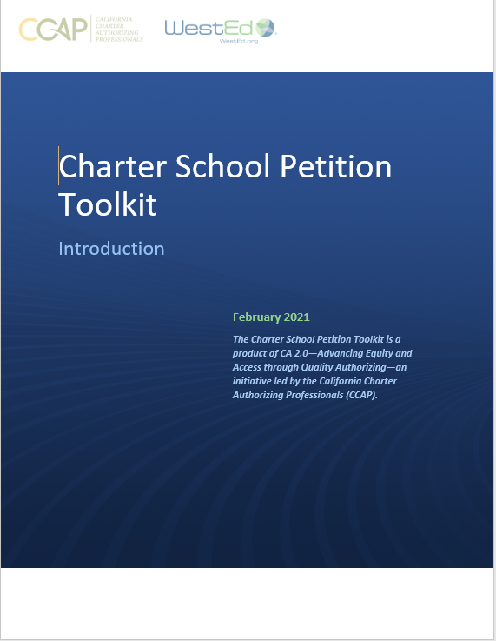
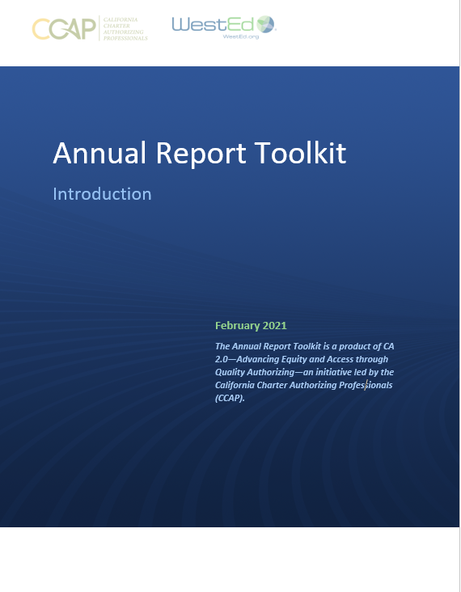
CA 2.0-Advancing Equity and Access Through Quality Authorizing
Notes:
Dave

Slide 12
Background/History

Slide 13
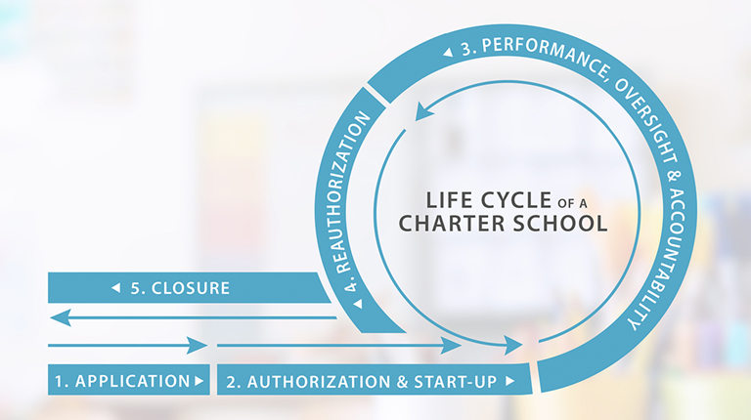

Slide 14
Charters at a Glance: National
Students Enrolled Nationally (3.3 million) (6.5% of student enrollment)
Charter Schools Nationally (7,500)
How Many State Have Charter Schools? (45 plus DC, PR and GU)
What States do Not? (MT, ND, NE, SD, VT)
Notes:
(WE NEED TO COVER DIFFERENCES BETWEEN LARGE CHARTER AUTHORIZER SHOPS AND SMALL)

Slide 15
Charters at a Glance: California
Students Enrolled in California (628,849) (10% of student enrollment)
Charter Schools in the State (1,337)
Number of Authorizers in California (337, 54 of 58 counties)
Notes:
(WE NEED TO COVER DIFFERENCES BETWEEN LARGE CHARTER AUTHORIZER SHOPS AND SMALL)

Slide 16
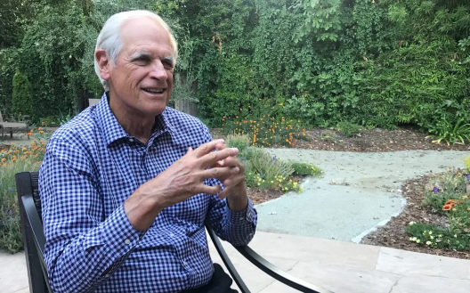
CHARTER SCHOOLS ACT 1992
Charter Schools are private schools
False
Any district or county board can approve charter schools
True
Charter Schools are operated by for profit corporations
False
Why created:
Parent choice,
innovation,
competition,
improve student outcomes,
new opportunities for teachers
Notes:
Corey

Slide 17
It is the intent of the Legislature…, to provide opportunities for teachers, parents, pupils, and community members to establish …schools…independently from the existing school district structure, …to accomplish…the following:*
(a) Improve pupil learning.
(b) Increase learning opportunities for all pupils, with special emphasis …for pupils …academically low achieving.
(c) …different and innovative teaching methods.
(d) Create new professional opportunities for teachers…
(e) Provide …expanded choices in the types of educational opportunities…within the public school system.
(f) …change from rule-based to performance-based accountability systems.
(g) Provide vigorous competition within the public school system to stimulate continual improvements..
*Ed Code 47601

Slide 18
Authorizing Is Primarily About The System, Not The Schools
Shift from traditional “geographic franchise” model of public education (monopoly)
Where all public school are owned and managed by geographically distinct, school districts that own the local franchise
To create an “open sector” within the public education system
Where other types of organizations may control and operate public schools, independent of the usual school district model
Shift from rule-based to performance-based accountability

Slide 19
“Mega-Waiver”
District
In the beginning
Charter
Now
Notes:
Corey

Slide 20
The Mega-Waiver
47601: Legislative intent
47605: Petition process
47610: Waiver and exceptions
From laws governing school districts
With specific exceptions
47612.5: And other district-like requirements (minimum minutes)
47605(l): And as included in charter content (credentials)
49414: And in other places in the code (e.g., Epi-pens), other statues that specifically mention charter compliance
Notes:
47605 – example add here
A specific provision in the charter schools statute, often called the “mega-waiver,” exempts California charter schools from most of the state laws governing school districts. (Ed. Code § 47610.) This provision means that charter schools are generally exempt from complying with the Education Code unless otherwise provided in their charter.
The Education Code has specifically identified legal requirements that charter schools must follow, including:
o Charter schools must comply with “[a]ll laws establishing minimum age for public school attendance.” (Education Code section 47610(c).)
o Charter school facilities must comply with the provisions of the Field Act (Education Code section 17280 et seq.) or the California Building Standards Code, unless otherwise exempt. (Education Code section 47610(d); 47610.5(b).) §
However, charter schools must comply with other laws governing the use and location of facilities, including local zoning requirements (unless exempted by a school district), and the California EPA.
o Charter schools must meet instructional minute requirements (Education Code section 47612.5(a)) and maintain an instructional track of no less than 175 days (Education Code section 47612(d)(3).)
o If the Charter document makes the State Teachers Retirement Plan or Public Employees’ Retirement System available to employees, the charter school must comply with the requirements stated for participation in those plans

Slide 21
County Boards and County Superintendents – Collaboration and Cooperation is Essential!
County Board Members are Elected Officials (typically)
County Superintendents of Schools are Elected Officials (typically)
Boards Approve or Deny Charters
Superintendents have direct responsibility for the staff of County Offices of Education, and typically for the oversight of charter schools approved by the Board
Notes:
Los Angeles Board of Directors are appointed by the County Board of Supervisors. (any others?)
53 out of 58 county superintendents are elected, 5 are appointed (Los Angeles, Sacramento, San Diego, San Francisco, Santa Clara)

Slide 22
County Board’s Role
Decision Maker
Collaboration with superintendent and staff
Making sure you get the information you need to make high quality decisions
Oversight - create clear and positive relationships
Ongoing review of the performance of the charter school(s)
Key considerations:
Working with the County Superintendent
Appeals from district boards
“De Novo” Review
Notes:
TOM
County Board Members are Elected Officials (typically)
County Superintendents of Schools are Elected Officials (typically)
Boards Approve or Deny Charters
Superintendents have direct responsibility for the staff of County Offices of Education, and typically for the oversight of charter schools approved by the Board

Slide 23
Your Special Role: Appeals from Denial of a Petition
From district to COE
From COE to SBE (except countywide)
District role:
Provide documentation of denial
Offered an opportunity to speak; can provide public comment
Not judging the district’s decision – de novo review
Often difficult role for the board AND staff

Slide 24
Staff’s Role
Process Board required actions (i.e. petition, renewals, NOV)
Review petitions
Conduct oversight on behalf of the Board
Ensure all laws are followed
Ensure required reports are submitted
Manage communicate with the school(s)
Process any complaints
Accountable to Superintendent (and not Board)
Notes:
COREY
County Board Members are Elected Officials (typically)
County Superintendents of Schools are Elected Officials (typically)
Boards Approve or Deny Charters
Superintendents have direct responsibility for the staff of County Offices of Education, and typically for the oversight of charter schools approved by the Board

Slide 25
Standard of Review – Reasons for Denial
The governing board of the school district shall not deny a petition for the establishment of a charter school unless it makes written factual findings:
Unsound educational program
Demonstrably unlikely to successfully implement the program
Does not contain the number of signatures (teachers or parents 50%)
Does not contain required affirmations/ assurances
Does not contain reasonably comprehensive descriptions
Does not declare it will be exclusive employer
Notes:
TOM
START INTRODUCING CHANGES IN LAW GOING FORWARD

Slide 26
Charter School Oversight
Statutory Oversight Requirements (EC 47604.32)
Identify at least one staff member as contact person for charter school
Visit each charter school at least annually
Ensure each charter school complies with all reports required of charter schools by law, including local control and accountability plan and annual update
Monitor fiscal condition of each charter school
Provide timely notification to CDE of renewal, revocation, or a charter school that ceases operations
Notes:
Stacey
A3 story

Slide 27
Renewal Law and Regulations
Overall Approach – Similar to initial approval, but some important differences because the school has a track record
Approve unless…. Default in the law is approval (uncommon legal language, but clearly stated in law for new petitions and renewals)
Notes:
Double check that the failure to act in xxx days results in an automatic renewal is still in place – in the regs

Slide 28
Notes:
Use in body instead of Q&A slides?

Slide 29
Process
Roles
Responsibilities

Slide 30
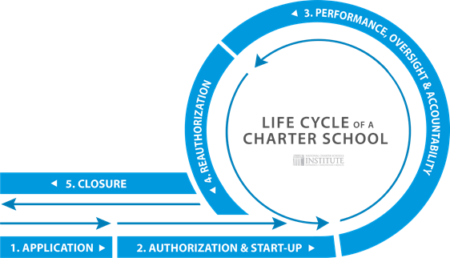
Notes:
Corey

Slide 31
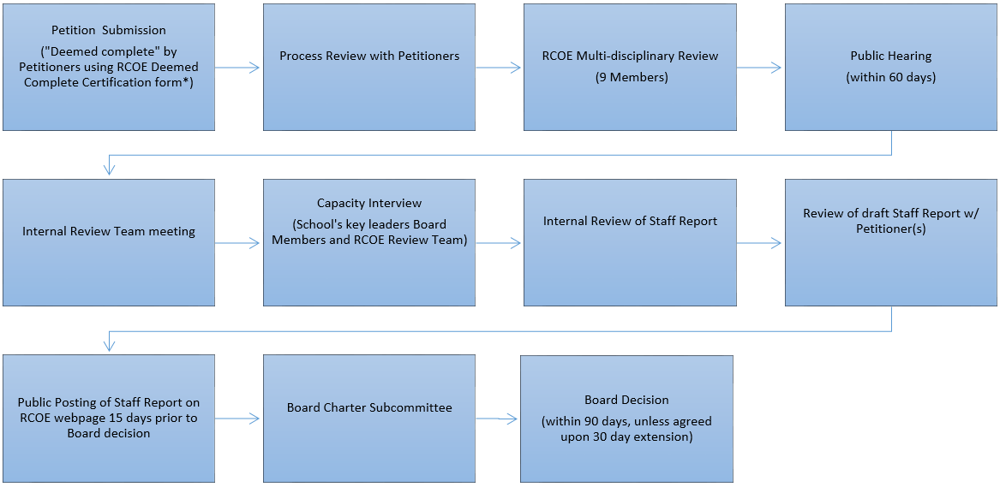
Petition Process
Notes:
Corey

Slide 32
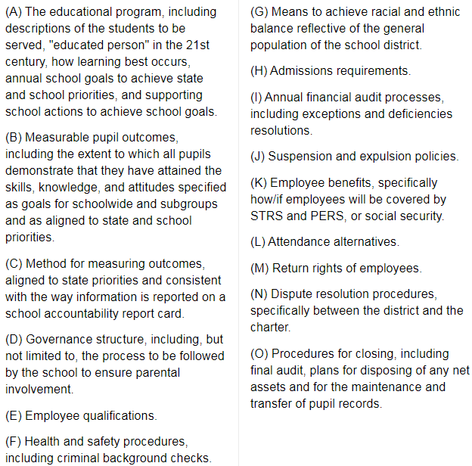
Petition Requirements (EDC 47605)
Notes:
Corey

Slide 33
Standard of Review – Reasons for Denial
The governing board of the school district shall not deny a petition for the establishment of a charter school unless it makes written factual findings:
Unsound educational program
Demonstrably unlikely to successfully implement the program
Does not contain the number of signatures (teachers or parents 50%)
Does not contain required affirmations/ assurances
Does not contain reasonably comprehensive descriptions
Does not declare it will be exclusive employer
Notes:
TOM
START INTRODUCING CHANGES IN LAW GOING FORWARD

Slide 34
Standard of Review – Reasons for Denial
New grounds:
7) “Unlikely to serve the interests of the entire community”: A) “Substantially undermine existing services; OR B) Duplicate programs
8) Qualified or Negative interim certificate (as defined by statue)
Notes:
TOM

Slide 35
Notes:
Corey

Slide 36
“Oversight”
CA2.0 Principle 1: The role of the authorizer is primarily regulatory
Statutory Oversight Requirements (EC 47604.32)
Identify at least one staff member as contact person for charter school
Visit each charter school at least annually
Ensure each charter school complies with all reports required of charter schools by law, including local control and accountability plan and annual update
Monitor fiscal condition of each charter school
Provide timely notification to CDE of renewal, revocation, or a charter school that ceases operations
Notes:
Tom CA2.0. then…
Corey
MENTION A3 Charter Schools! (Tom can chime in too)

Slide 37
CA2.0 Core Charter Performance Questions
Is the charter school’s educational program a success?
Is the charter school financially viable?
Is the charter school operating and governed effectively?
Is the charter school serving public policy purposes?
Notes:
Tom (White Paper)

Slide 38
Oversight Principles
CA2.0 Principle 2: The first level of oversight responsibility resides with charter school governing boards
CA2.0 Principle 3: There are fundamental performance-based measures of charter school quality that can be identified and measured
CA2.0 Principle 4: The intensity of oversight is tied to the charter school’s results with respect to the Key Performance Indicators
Notes:
Tom (White Paper)

Slide 39
Key Practices
Site Visits
Annual report or reporting
Close and regular monitoring of finances
Monitoring of charter board meetings
Dashboard
LCAP
Board engagement with school(s) (i.e. reports)
Maintain open and positive relationship
Notes:
Corey
CA2.0 Principle 2: charter school’s own board

Slide 40
Renewals
Notes:
Corey

Slide 42
Discussion of Legislative Changes - 1
District/County has 30 more days to consider a charter petition and renewal
Clock starts on date petition submitted
Staff finding must be published 15 days before public hearing
Equal time for petitioners at public hearing
New criteria for denial of a new petition (not renewal)
Not serve the interest of the entire community
Would substantially undermine existing district services
Is the district not able absorb the fiscal impact of the proposed charter school
Qualified interim certification, negative certification or is under receivership
Notes:
WE GO IN DEPTH STARTING HERE

Slide 43
Discussion of Legislative Changes - 2
Additional Charter Petition Elements
Tighter alignment to the goals and outcomes of the state dashboard priorities
Expand the means to achieve a racial and ethnic balance to include English Learners and students with disabilities
As supplemental information, the names and qualifications for the charter’s nonprofit governing board
Requires a charter school that seeks to add additional grade levels to submit this as a material change
Removes charter school flexibility for teachers, requiring the same credentialing (exemption till June 30, 2025 of existing staff)
Notes:
Stacey
fiscal impact considerations only to new petitions or existing schools that are expanding to one or more additional sites or grade levels beyond what is already approved in the charter

Slide 44
Discussion of Legislative Changes - 3
Charter Appeals
Appeals must be submitted within 30 days
The new timelines for considering new petitions also apply to appeals
Two new criteria for denial of new petitions also apply to appeals
Clarifies what updated information can be submitted with an appeal
Includes a remand to the district if substantive changes are made
Continues de nova review by the county (but must review fiscal impact)
State Board Appeals have changed significantly
New standard of review is “abuse of discretion”
Exception is for districts that are also counties
County-wide Benefit Charters
No substantive changes except to conform with the procedural changes made for petitions submitted to district
Notes:
Dave
fiscal impact considerations only to new petitions or existing schools that are expanding to one or more additional sites or grade levels beyond what is already approved in the charter

Slide 45
Discussion of Legislative Changes - 4
Charter Renewals
The new timelines for considering new petitions also apply to renewals
Two new criteria for denial does not apply to renewals, only to new petitions or existing schools that are expanding
Clarifies what updated information can be submitted with an appeal
Includes a remand to the district if substantive changes are made
Continues de nova review by the county
State Board Appeals have changed significantly
New standard of review is “abuse of discretion”
Exception is districts that are also counties
County-wide Benefit Charters – No Appeals
Notes:
Dave
fiscal impact considerations only to new petitions or existing schools that are expanding to one or more additional sites or grade levels beyond what is already approved in the charter

Slide 46
Renewal Criteria – New Law Unanswered Questions
New and additional criteria:
Demonstrably unlikely to successfully implement the petition due to substantial fiscal or governance factors; OR
Not serving all pupils who wish to attend.
Notes:
Area where there are no clear answer yet
Review new law on this

Slide 47
CA 2.0-Advancing Equity and Access Through Quality Authorizing
Notes:
Dave

Slide 48
Notes:
Use in body instead of Q&A slides?

Slide 49
Notes:
Stacey
No dashboard, not sure what will happen in assigning charter to Tiers for compensate for no data – Stacey is going to do homework

Slide 50
Criteria
Dashboard
Any new laws
Enrollment data
Academic Performance of significant student groups compared to state based on VERIFIABLE data
1:1 year growth
New reasons to deny cannot be considered (i.e. fiscal impact – #s 7,8)
Sound governance, financials and operations
If non-renewal, "closure is in the best interest of the students"
Notes:
I think I want to move this, not sure where yet.

Slide 51
"Shall not deny"
Any major issues/ concerns must follow NOV
5-7 yrs
"Shall deny"
"Clear and convincing evidence": Strong plan and growth = 2 yrs
Notes:
Tier 3 - go back to authorizing questions - why fight for this school? – move this discussion to slide 43 and 44

Slide 52
"Shall grant" renewal
"Shall have clear and convincing evidence" of growth
No major issues/ concerns
5 yrs

Slide 53
TOP TIER DENIAL
Substantial fiscal or governance factors, or is not serving all students who wish to attend (i.e. unlawful suspensions, expulsions or dismissals)
Must issue Notice of Violation (Board action, 30 days to cure/ correct)
May deny only by either finding:
Corrective action has been unsuccessful; OR
Violations are severe and pervasive (i.e. criminal activity, unsafe)
Notes:
Presumption is approval; heavy lift to deny
May deny due to demonstrably unlikely to successfully implement the program due to substantial fiscal or governance factors or is not serving all students who wish to attend
Must give at least 30 days’ notice of the alleged violation and a reasonable opportunity to cure, including a corrective action plan
Authorizer must make either of the following findings: Corrective action plan has been unsuccessful; violations are sufficiently severe and pervasive as to render a corrective action plan unviable

Slide 54
BOTTOM TIER
"Shall not renew" if Red/ Orange on all state indicators OR
All measurements of academic performance are the same or lower than the state average; AND
Majority of subgroups that are performing below state average (i.e.unduplicated)
Notes:
Presumption is not renew.

Slide 55
BOTTOM TIER RENEWAL
"May renew" only upon making both written findings:
School is taking meaningful steps to address underlying cause of low performance, reflected in written plan adopted by the charter school Board AND
"Clear and convincing evidence" showing either:
Achieve measurable increases in academic achievement (1:1 yr. progress); OR
Strong postsecondary outcomes (college enrollment, persistence, and completion rates equal to similar peers)
Two-year renewal
Notes:
School can provide additional data (role of verified data), and authorizer is required to review
This is the second look
Talk about the Escondido suit recently filed

Slide 56
MIDDLE TIER DENIAL
May deny only upon making written findings of the following:
School failed to meet or make sufficient progress toward meeting standards; AND
Closure is in the best interest of students; AND
Its decision placed greater weight on performance on academic measures
5 year renewal

Slide 57
Alternative Schools (DASS)
Presumption is renewal
May deny renewal by finding the closure of the school is in the best interest of students
Authorizer and charter school should have mutually agreed upon alternative metrics defined
Academic performance
Notes:
Stacey –
Stacey – will add something about the criteria for her school
Authorizer shall consider performance on:
• State and local indicators, and
• Dashboard uses 1-year grad rate, different CCI
• Alternative metrics applicable to the charter school based on
the pupil population served.
• Shall “mutually agree to discuss” alternative metrics
with charter school

Slide 58
Do you have any schools up for renewal?
Do you know where they stand?
Any thoughts of what “tier” they are on?
Any DASS schools?
CA2.0 Principle 5: The authorizer communicates results of monitoring to the charter school, laying a foundation for future decisions
Notes:
Tom

Slide 59
The Annual Report Toolkit
A new tool - the Annual Report Toolkit

Slide 60
Notes:
Use in body instead of Q&A slides?

Slide 61
COVID-19 Has Changed EVERYTHING
Hard to overstate how much COVID-19 has disrupted K-12 education
Widespread and deep learning loss
State and federal priorities
Charter school oversight (Job 1? – NOT!)
Notes:
Who?

Slide 62
Charter School Oversight (Job 1 – NOT!)
Overwhelming press of other district priorities
Charter schools struggling to cope with dramatic change too – that has been their focus
No statewide assessments, no Dashboard
Limited LCAP, Alternative and Local Metrics
Notes:
Stacey
(what about EL?) Stacey….
(CA statewide testing doesn’t have growth data)
Actually, new LCAP cycle starting this year (2021) with an expanded Annual Update which covers the 19-20 LCAP and the 20-21 LCP.

Slide 63
The Challenges of High-Stakes Accountability in California
The challenges caused by COVID-19
For all schools
For charter schools
The responsible use of high-stakes accountability requires that the measurements to be used are valid and reliable FOR THE PURPOSE THE MEASUREMENTS ARE BEING USED
Notes:
Stacey – can tell her story
Discuss what is a high stakes decision, the need for measurements to be valid and reliable FOR THE PURPOSE THE MEASUREMENTS ARE BEING USED.
The challenges faced by CA authorizers because of the lack of CAASP and Dashboard data, and/or that the data is incomplete, and this results in the data available being inadequate to make high quality high stakes decisions,

Slide 64
Considerations, Especially During COVID
CA2.0 Principle 5: The authorizer communicates results of monitoring to the charter school, laying a foundation for future decisions
Transparency is critical
Recognize these are extraordinary times; be flexible and supportive
Focus on student equity issues, especially pandemic-related
If schools up for renewal have serious problems, do deal with them
Fiscal, compliance, and governance are higher risk during pandemic
Maintain positive, professional relationships
Assume best motives -- unless provided with factual information
Notes:
Tom

Slide 65
Notes:
Use in body instead of Q&A slides?

Slide 66
Resources
CA2.0 Principle 6: Implementing the process for effective authorizing must be within the capacity of all entities that serve as authorizers
PDF version of this PowerPoint
CCAP Authorizing 2.0 & Resources: https://calauthorizers.org
COVID, incl. PROCESSING CHARTER SCHOO RENEWALS IN 2020-21 & 2021-22 SCHOOL YEARS: A PLANNING GUIDE
California School Dashboard Technical Guide:
https://www.cde.ca.gov/ta/ac/cm/documents/dashboardguide19.pdf
CDE on COVID: https://www.cde.ca.gov/ls/he/hn/coronavirus.asp
NACSA on COVID: https://www.qualitycharters.org/covid19/
Notes:
Tom

Slide 67
Contact info
Dr. Stacey Adler, Mono County Superintendent of Schools
sadler@monocoe.org
760-934-0031
www.monocoe.org
Dr. David Patterson:
david.patterson@calauthorizers.org
www.calauthorizers.org
916-801-2454

Slide 68
Thank you!

Slide 69
About CCAP
Founded by a group of committed California authorizers with a mission to advance quality public education for all students
National Dissemination Grant recipient from the U.S. Department of Education’s Office of Innovation to improve charter school authorizing best practices, partnering with Colorado and Florida in the Tri-State Alliance for Improving District-Led Authorizing
www.calauthorizers.org
Notes:
Tom

