Slide 1
California Charter Authorizing Professionals
Recap of the 2022-23 Governor’s Budget
Presented By:
Brianna García, Vice President
School Services of California Inc.
and
CCAP Board Member

Slide 2
2022-23 LCFF Overview
$3.3 Billion
Funds the 5.33% statutory COLA
$70.5 Billion
Total 2022-23 LCFF funding
$587
Approximate average increase in per-pupil funding
(individual amounts will vary)
Average ADA
Proposed change to help school districts with the fiscal impacts of declining enrollment

Slide 3
2022-23 LCFF Funding Factors
  Grade span adjustments (GSAs) applied as percentage increases to the base grants
    Grades K-3—10.4%
    Grades 9-12—2.6%
GSA
COLA
5.33% estimated statutory COLA applied to the base grants
Unduplicated pupil percentage (UPP)—LEA’s enrolled students who are English learners, free or reduced-price meal program eligible, or foster youth
UPP
S/C
Supplemental and concentration (S/C) grants calculated based on the UPP

Slide 4
2022-23 LCFF Funding Factors
Grade Span | K-3 | 4-6 | 7-8 | 9-12
2021-22 Base Grant per ADA | $8,093 | $8,215 | $8,458 | $9,802
5.33% COLA | $431 | $438 | $451 | $522
2022-23 Base Grant per ADA | $8,524 | $8,653 | $8,909 | $10,324
GSA | $886 | – | – | $268
2022-23 Adjusted Base Grant per ADA | $9,410 | $8,653 | $8,909 | $10,592
20% Supplemental Grant per ADA (Total UPP) | $1,882 | $1,731 | $1,782 | $2,119
65% Concentration Grant per ADA (UPP Above 55%) | $6,117 | $5,624 | $5,791 | $6,885

Slide 5
SSC Financial Projection Dartboard
Planning Factors
 | 2021-22 | 2022-23 | 2023-24 | 2024-25 | 2025-26
DOF* Planning COLA | 5.07%** | 5.33% | 3.61% | 3.64% | 3.62%
CalSTRS*** | 16.92% | 19.10% | 19.10% | 19.10% | 19.10%
CalPERS*** | 22.91% | 26.10% | 27.10% | 27.70% | 27.80%
Unemployment Insurance | 0.50% | 0.50% | 0.20% | 0.20% | 0.20%
*Department of Finance (DOF)
**Calculated by compounding the unfunded COLA of 2.31% from 2020-21 and the statutory COLA of 1.70%, plus 1.00%, in 2021-22
***California State Teachers' Retirement System (CalSTRS); California Public Employees’ Retirement System (CalPERS)
COLA is at higher levels
  But so are the projected cost increases that are facing LEAs
The journey the COLA has taken us on has been quite a wild ride

Slide 6
2022-23 LCAP and 2021-22 LCAP Supplement
The LCAP must be posted as one document and include the following components in the following order:
Supplement to the Annual Update to the 2021-22 LCAP
Budget Overview for Parents
Completed LCAP Template
LCAP Template Instructions
Action Tables

Slide 7


2021-22 Supplement—What’s Due
LEAs are required to present “an update on the annual update to the 2021-22 LCAP and budget overview for parents” on or before February 28, 2022, at a regularly scheduled meeting, which includes one-time supplement as well as all available mid-year outcome data related to metrics and mid-year expenditure and implementation data included in the 2021-22 LCAP
There is only one template—Supplement to the Annual Update to the 2021-22 LCAP (Supplement)
  LEAs are not being asked to update the 2021-22 LCAP annual update nor the budget overview for parents separately
There is no separate template or specific document that an LEA must use when providing mid-year outcome and expenditure data—at discretion of LEA
Supplement will be part of the review, adoption, and approval process for the 2022-23 LCAP

Slide 8
Declining Enrollment Projections 2021-22 to 2030-31
Most areas in the state are affected by declining enrollment, but to differing degrees:
  10 counties are projected to lose 10,000 or more students between 2021-22 and 2030-31
  19 counties will lose students at a rate faster than the statewide average of 8.7%
Enrollment trends for each LEA are unique to the community and student populations they serve
Enrollment trends impact the bottom line—in the current year and the out-years
Source: Department of Finance

Slide 9
2022-23 ADA “Cliff”
The ADA “Cliff” has been well-publicized and the subject of many discussions
  For charter schools and COEs, the impact is already being felt in 2021-22
Good news—the Governor and Legislature are listening and hearing your collective voices
2019-20
2020-21
2021-22
2022-23
ADA
Funded ADA
Based on 2019-20
Funded ADA Based on 2019-20
The Cliff
2020-21
Actual ADA
2021-22
Actual ADA
Funded ADA
Based on 2021-22
2022-23
Actual ADA
© 2022 School Services of California Inc.

Slide 10
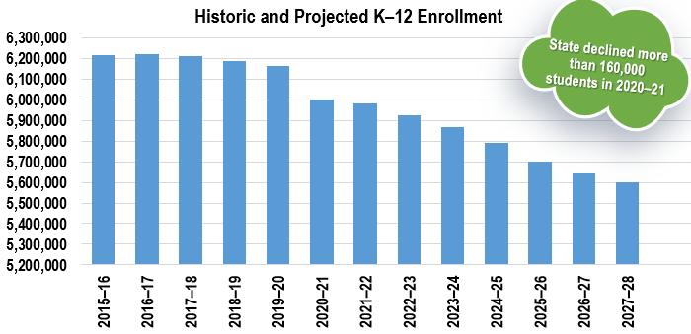
2022-23 ADA “Cliff”
The ADA “Cliff” has become a two-headed monster—the combination is significant
Declining Enrollment
ADA-to-Enrollment Percentage
The rate at which children are attending school is on the decline
  In Person
  Independent study
    Unsigned master agreements
    Homework not returned in a timely manner
Source: Department of Finance (DOF) Demographic Research Unit, revised June 2021
Actual enrollment data through 2020-21

Slide 11





ADA Cliff—Proposed Solution
Many solutions have been entertained, and the Governor included one additional option:
Education Code Section (EC §) 42238.05(a)(1) provides funding through the LCFF on the greater of:
Current Year ADA
or
Prior Year ADA
Funding would be based on the greater of:
Current-Year ADA,
Prior-Year ADA
or
Computed average ADA using the prior three years’ ADA
Current Law for
School Districts
Governor’s Proposal for
School Districts

Slide 12
ADA Cliff—Proposed Solution
Hypothetical scenario for school districts
Fiscal Year | Actual ADA
2019-20 | 10,000
2020-21 | 10,000*
2021-22 | 9,500
2022-23 | 9,250
Funded ADA for 2022-23 | Funded ADA
Current Law | 9,500
Governor’s Proposal | 9,833
Difference | 333
*Result of hold harmless
Goal is to turn the ADA cliff into an ADA softer landing
The proposed solution would not apply to charter schools, but the Governor intends to engage in outreach and discussions with interested charter school parties
  No future changes were noted for COEs

Slide 13
School Facility Investments
Governor Newsom proposes an unprecedented one-time General Fund appropriation of
$2.225 billion for school construction projects through the School Facility Program
Also proposes an ongoing $30 million Proposition 98 appropriation for the Charter School Facility Grant Program and to sell the remaining $1.4 billion in Proposition 51 bonds
The Governor’s appropriation would fund approximately 75% of the project applications received by the Office of Public School Construction that are beyond current bond authority
School Facility Program (in millions)
 | New Construction | Modernization
Unfunded (Workload) List | $163.1 | $1,004.2
Acknowledged List | $1,430.2 | $1,662.8

Slide 14

Universal Meals Program
Beginning in 2022-23, LEAs must provide free breakfast and lunch each school day to any student requesting a meal, regardless of free or reduced-price meal eligibility
In order to receive state reimbursement for the two meals, LEAs must participate in both the National School Lunch Program and School Breakfast Program
State intends to reimburse LEAs at the free meal rate, minus federal and state reimbursements for meals
  LEAs with defined high-poverty schools are also required to adopt a universal meal service provision, such as the Community Eligibility Provision or Provision 2
All meals served must meet federal requirements for nutrition and reimbursement
There is no waiver for the program
© 2022 School Services of California Inc.
13

Slide 15
Special Education
In the wake of $3.1 billion in special education investments over the last three years, Governor Newsom reinforces his commitment to young children and students with disabilities by proposing an integrated package of investments in early prevention and intervention and proposes commitments for ongoing special education funding
  $500 million in Proposition 98 General Fund special education funding
  5.33% COLA adjustment—$140.6 million
    These investments result in a Base Rate increase estimated at $820 per ADA
    Funds will continue to flow through the AB 602 Funding Formula via Special
    Education Local Plan Areas (SELPAs)
  2019-20
  Statewide Target Rate—$545
  2020-21
  Base Rate—$625
  2021-22
  Base Rate—$715
  2022-23
  Base Rate—$820

Slide 16
Legal Requirements of Universal TK
2021-22
2022-23
2023-24
2024-25
2025-26
Offer TK to
four-year-olds whose fifth birthday
occurs between
September 2 and December 2
Expand offer of TK to four-year-olds whose
fifth birthday
occurs between
September 2 and February 2; inclusive
Expand offer of TK to four-year-olds whose
fifth birthday
occurs between
September 2 and April 2; inclusive
Expand offer of TK to four-year-olds whose
fifth birthday
occurs between
September 2 and June 2; inclusive
Expand offer of TK to three-year-olds whose
fourth birthday
occurs
by September 1; inclusive
Education Code Sections (EC §) 48000(c)(1)(C)—(G)

Slide 17
Summary of Plans for Categoricals
A new era is here—additional funding equals more plans
To assist with tracking, SSC has summarized the required plans, including the approval requirements
Plan | Link to Plan Template/More Information | Deadline
LCAP Supplement | https://www.cde.ca.gov/re/lc/ | Consideration by local governing board by February 28, 2022
A-G Completion Improvement Grant | To be determined EC § 41590(f) | Develop a plan by April 1, 2022; discuss and adopt (two separate meetings)—dates to be determined
Pre-Kindergarten Planning and Implementation Grant | https://www.cde.ca.gov/ci/gs/em/documents/finalupktemp.doc | Consideration by local governing board by June 30, 2022
Expanded Learning Opportunities Program Plan | https://www.cde.ca.gov/ls/ex/documents/elopprogplanguide.pdf | Approved in a public meeting and posted on the local educational agency’s website—dates to be determined
ESSER I, II, and III Quarterly and Annual | https://www.cde.ca.gov/fg/cr/anreporthelp.asp | Various—https://www.cde.ca.gov/fg/cr/reporting.asp
GEER* I Quarterly and Annual | https://www.cde.ca.gov/fg/cr/anreporthelp.asp | Various—https://www.cde.ca.gov/fg/cr/reporting.asp
*Governor’s Emergency Education Relief (GEER)

Slide 18


Slide 19
Thank you!
Brianna García
briannag@sscal.com

Slide 20

California Charter Schools
High-Quality Authorizing
Fiscal Oversight for Authorizers
January 25, 2022

Slide 21
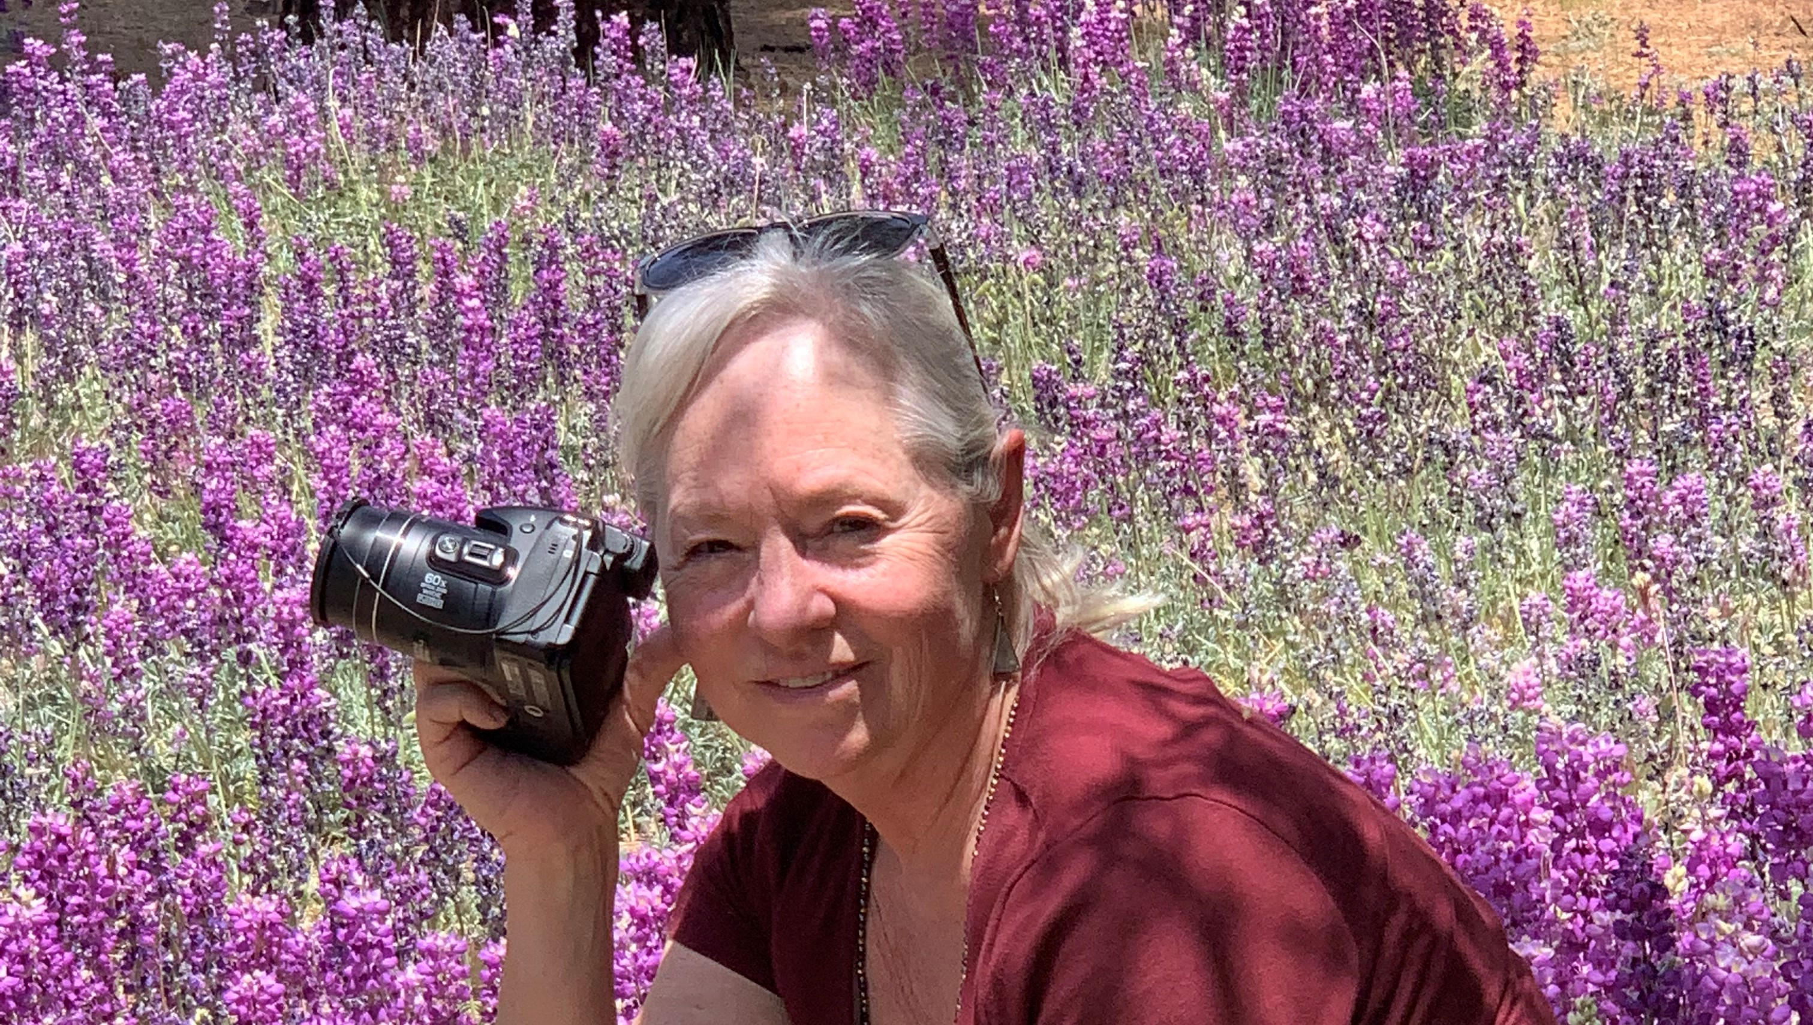
Your Presenter Today
Debi Deal,
CCAP Treasurer
Notes:
Tell them background!

Slide 22
California Charter Authorizing Professionals
Founded in 2013 by group of committed authorizers to advance quality public education for all students
New National Dissemination Grant from U.S. Department of Education’s Charter Schools Program to improve authorizing
  Partnering with Colorado and Florida in Tri-State Alliance for Improving District-Led Authorizing
  Formed the National Network for District Authorizing (NN4DA)
New California Department of Education Authorizer Technical Assistance Grant to provide charter school oversight and monitoring; technical assistance; professional development and develop professional networks.

Slide 23
Themes for Today
Key Takeaways & Free Tools
Remember, we are all in this together!
What you need to know about fiscal oversight during and post-COVID
Legislative changes on the horizon
Critical timelines, new grants, investments and initiatives
    Board approvals and reporting requirements
The CCAP Website
  Check out our NEW Authorizer Toolkits
  CCAP Resource Library for Authorizers

Slide 24
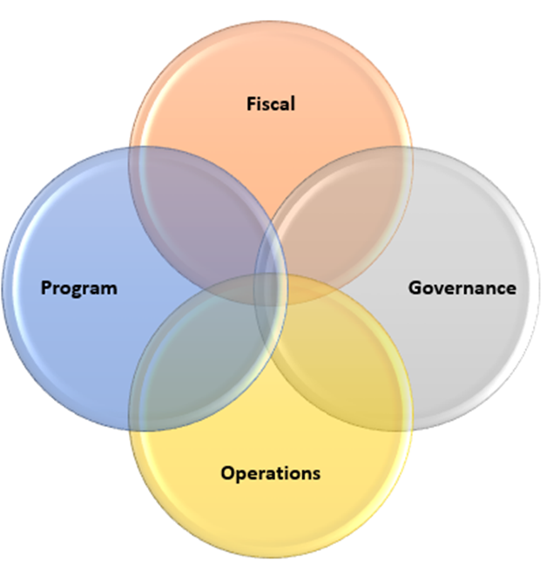


Planning For Success Needs All the Component Parts Working Together Including A Good Working Relationship With Our Charter Schools
Notes:
Today we will focus on the Fiscal
This also means authorizers and charters working together!

Slide 25
COVID-19 Has Changed EVERYTHING Including New Funding Opportunities
Federal money: ESSER I, II & III; CARES Act
State money: New one-time & on-going initiatives and investments

Slide 26
What is the Authorizer’s Role With Fiscal Oversight?
Building a partnership, providing support and good communication is essential to the overall relationship and provides documentation for renewal.
Authorizers should provide key fiscal information to charters on major budgetary financial updates that affect budget assumptions.
Understanding the components of new funding sources and requirements helps authorizers evaluate the budgets and overall financial status of authorized charters.

Slide 27
Brief summary of major legislative changes that affect charter authorizing
New funding sources, requirements and timelines
Key ingredients to maximize revenues – a financial framework
How to align all these resources to a strategic plan
Where to find help and resources
Topics For Today

Slide 28
Major Legislative Changes & Funding Opportunities
A Review
Major legislative Changes Include:
  AB 1505
  AB/SB 130
  AB/SB 167
Notes:
Dave
These are the key bills - SB 126, AB 1505, AB 1507, SB 130 and AB/SB 167
If nothing else was occurring in the education space – no COVID 19 – the changes to charter school law in the last few years are a BIG deal
The pandemic and its impact has been all consuming for all educators, for school and county boards, families as well as the legislature and the governor.
This session is too short to be comprehensive. Out time together today will focus on just a few, and certainly not all, of the important changes.

Slide 29
Petition Approval Criteria
Petition Review Timeline
Petition Renewal Criteria
Teacher Credentialing
AB 1505
Signed Into Law on 10/3/2019
Petition Approval/Renewals

Slide 30
AB130 – Comprehensive Trailer Bill to the State Budget Act
Prop 98 enhancements and new investments
Includes:
Program expansions
New initiatives
One-time investments
One-time independent study requirements for 2021-22

Slide 31
LEAs can receive apportionment through IS for students that quarantine from 9/2/2021 through 6/30/2022
Due to staffing shortfalls NOT COVID CLOSURES
Prohibits LEAs from filing a J-13A waiver for a “material loss” in ADA or school closure due to quarantine.
Protection for shortages based on staff quarantine as a result of exposure to COVID-19 and has exhausted all staffing options.
Makes technical changes to AB 130 especially for Independent Study (IS) and J-13A waivers
AB 167
Signed Into Law on 9/23/2021
TK-12 Omnibus Budget Trailer Bill

Slide 32
AB 167
Protections for Classroom-Based Charters
CDE: Q & A:
Will a classroom-based charter school be required to obtain a funding determination for ADA generated from students who are subject to quarantine for exposure to, or infection with COVID-19 pursuant to local or state health guidance and cannot participate in classroom-based instruction due to quarantine or school closure due to COVID-19? (26-October-2021)
No. For FY 2021–22 only, a classroom-based charter school will not be required to submit a funding determination if their nonclassroom-based ADA as a result of providing independent study to pupils during quarantine or school closure due to COVID-19, when combined with all other nonclassroom-based ADA, exceeds 20% of the total ADA.
Charter schools should report their nonclassroom-based ADA for 2021–22 as follows:
Nonclassroom-based ADA that is generated as a result of providing independent study to pupils during quarantine or school closure due to COVID-19 should be reported as classroom-based ADA.
Nonclassroom-based ADA that is not generated as a result of providing independent study to pupils during quarantine or school closure due to COVID-19 should be reported as nonclassroom-based ADA [EC 51747(j)(2)-(3)].

Slide 33
AB 167
Additional Resources
Special thanks to Los Angeles County Office of Education Business Services Team for online resources and clarifications.
LACOE AB 167 Amendments to AB 130

Slide 34
Some New Funding Sources
Program | Funding Is Based On:
ESSER (Elementary & Secondary School Emergency Relief Fund) I, II, III | Federal One-time funding: Title I
GEER – Governor’s Emergency Education Relief | State One-time funding: Portion of Learning Loss Mitigation funds derived from Federal CARES Act
Educator Effectiveness Block Grant | Prop 98 One-time funding FTE Counts: CALPADS & CBEDS – Oct
LCAP Supplement | Prop 98 On-Going Funding: Concentration Grant: Increased the percentage of Unduplicated Pupils from 50% to 65% of base grant
A-G Completion Improvement Grant | Prop 98 One-Time Funding: Grades 9-12 Unduplicated Pupils
Pre-K Planning & Implementation Grant | Prop 98 On-going to be phased in starting 2022-23 through 2025-26 Primarily kindergarten unduplicated counts
Expanded Learning Opportunities Program (Different from ELO Grant!) | Prop 98 One-time Funding: TK-6 Unduplicated counts
Share With Your Charters

Slide 35
Timelines, Links & Templates
Program | Timelines, Links & Templates (if available) | Deadlines
ESSER (Elementary & Secondary School Emergency Relief Fund) I, II, III | Reporting quarterly and annually. http://www.cde.ca.gov/fg/cr/anreporthelp.asp | See reporting link – various timelines
GEER – Governor’s Emergency Education Relief | Reporting quarterly and annually. http://www.cde.ca.gov/fg/cr/anreporthelp.asp | See reporting link – various timelines
Educator Effectiveness Block Grant | Allowable uses: https://www.cde.ca.gov/pd/ee/eef2021.asp | Two separate meetings by December 30, 2021- discuss and adopt. No template yet.
LCAP Supplement | https://www.cde.ca.gov/re/lc/ | One-time reporting for the additional 15% add-on. Board approval by February 28, 2022.
A-G Completion Improvement Grant | https://www.cde.ca.gov/fg/fr/eb/yr21ltr0811.asp EC § 41590(f) | Two separate meetings by April 1, 2022- discuss and adopt.
Pre-K Planning & Implementation Grant | https://www.cde.ca.gov/fg/fr/eb/yr21ltr0811.asp EC § 8281.5 (c)(3)(B) | Board approval by June 30, 2022.
Expanded Learning Opportunities Program (Different from ELO Grant!) | https://www.cde.ca.gov/ls/ex/ | TK – 6: Funding for after school and during intersession
Share With Your Charters

Slide 36
Upcoming Timelines
CALPADS Fall 1 Collection Certification
The certification window ends December 17, 2021
Final “Amendment Window” on January 28, 2021
LCAP Supplement
This is for the additional 15% add-on for Concentration Grant funding, if applicable
Due on or before February 28, 2022

Slide 37
Aligning All the Resources to the
Strategic Plan
Start with LCAP
The LCAP is the central strategic plan for districts and charters
1
One-time dollars
Align based on allowable use & timeline to use the funds
2
Federal and Other State dollars
Utilize other State and Federal entitlements and grants based on allowable use
3

Slide 38
Key Ingredients to Maximize Revenues
Enrollment
Average Daily Attendance
CALPADS Unduplicated Pupils Counts
Adhere to Funding Requirements
Watch for Board Approval Deadlines
Timely Reporting

Slide 39
Just In For This Year!
Three New Programs Based on Prior Year CALPADS Certified Data
Some New Funding Allocations Based on 2020−21 Certified CALPADS Data
AB 130 authorized several new programs; some will use 2020−21 certified CALPADS data as a basis to determine funding allocations.
This emphasizes the importance of ensuring the accuracy of CALPADS data, providing additional resources for data collection and training.
Notes:
More on this later in this session about CALPADS and the importance of good data and maximizing funding

Slide 40
Note
Three New Programs Based on Prior Year CALPADS Certified Data
Three New Funding Allocations Based on 2020−21 Certified CALPADS Data
Continuing the theme that grant funding will be based on data collections through CALPADS. This list expands every year!
New programs that will utilize 2020-21 CALPADS data include:
Educator Effectiveness Block Grant
A-G Completion Improvement Grant Program
Expanded Learning Opportunities Program
Notes:
More on this later in this session about CALPADS and the importance of good data and maximizing funding

Slide 41
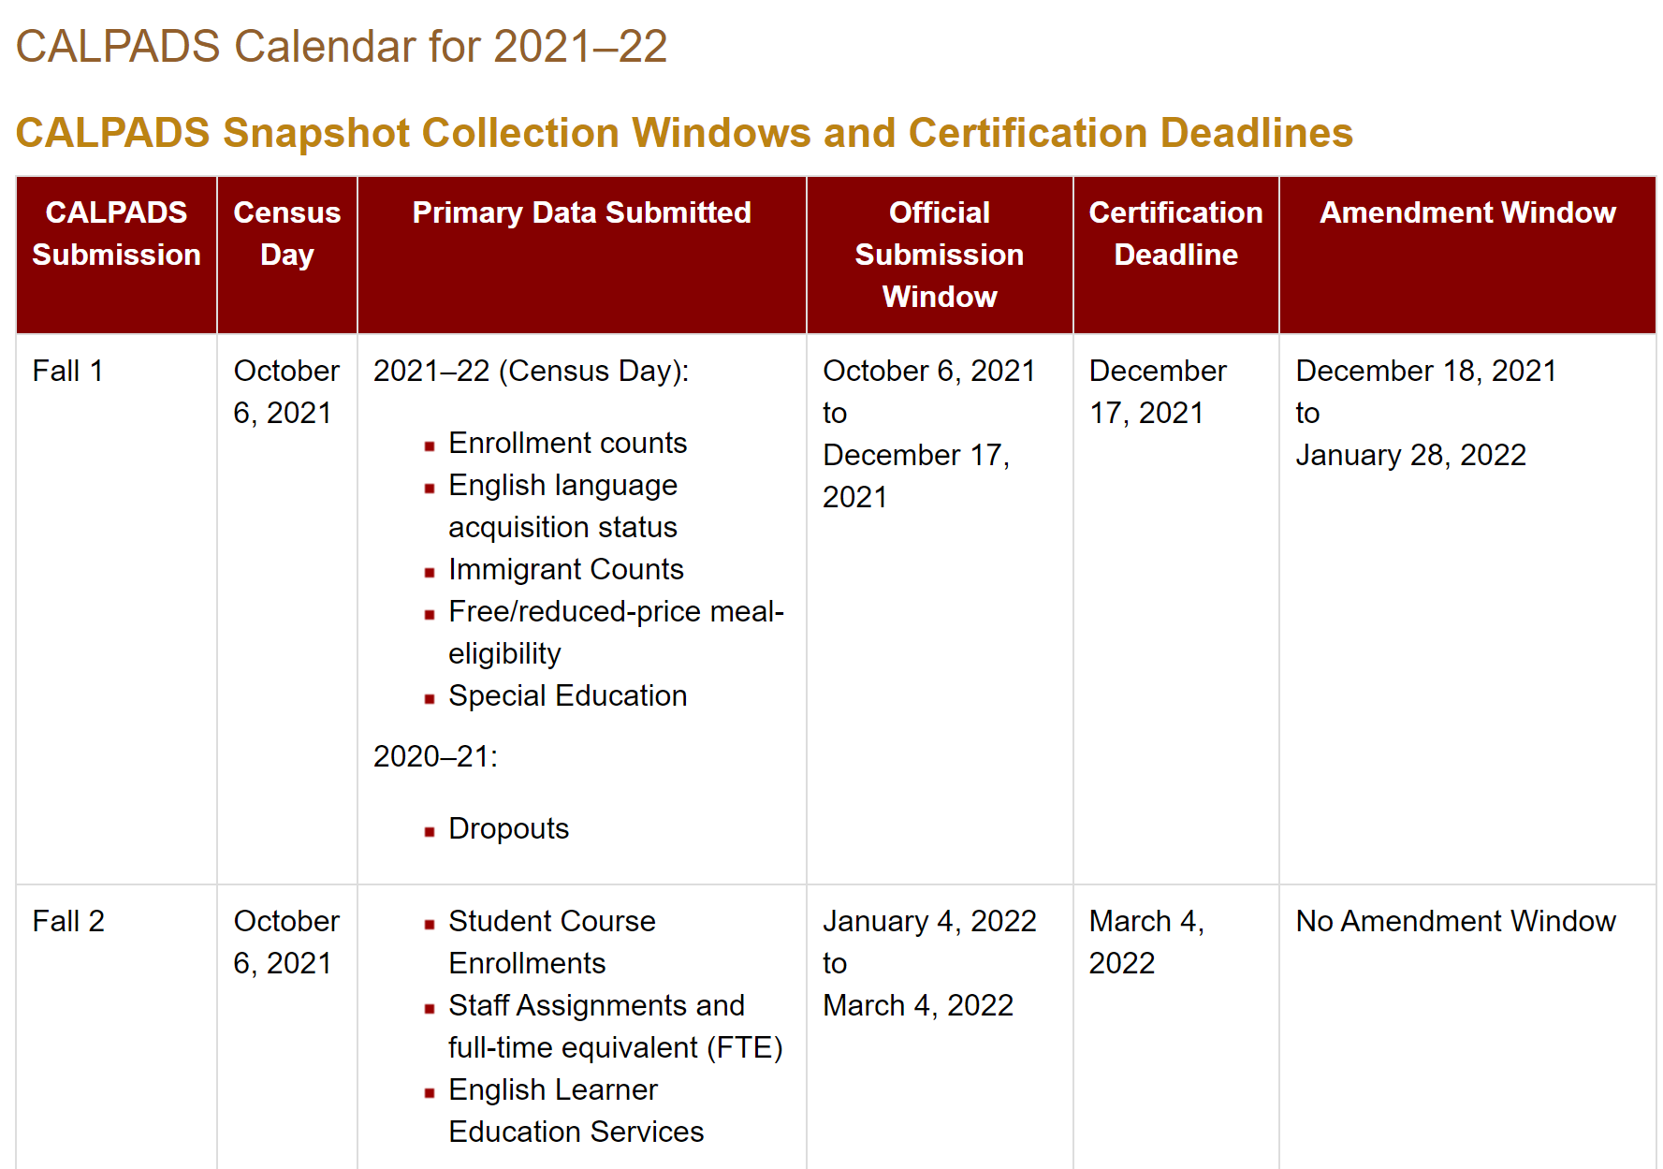
FCMAT/CSIS
CALPADS Fall 1 & 2 Calendar
Notes:
Talk about the importance of the CALPADS collection on Fall 1 & 2 which establishes the official enrollment and unduplicated counts for the current fiscal year.

Slide 42
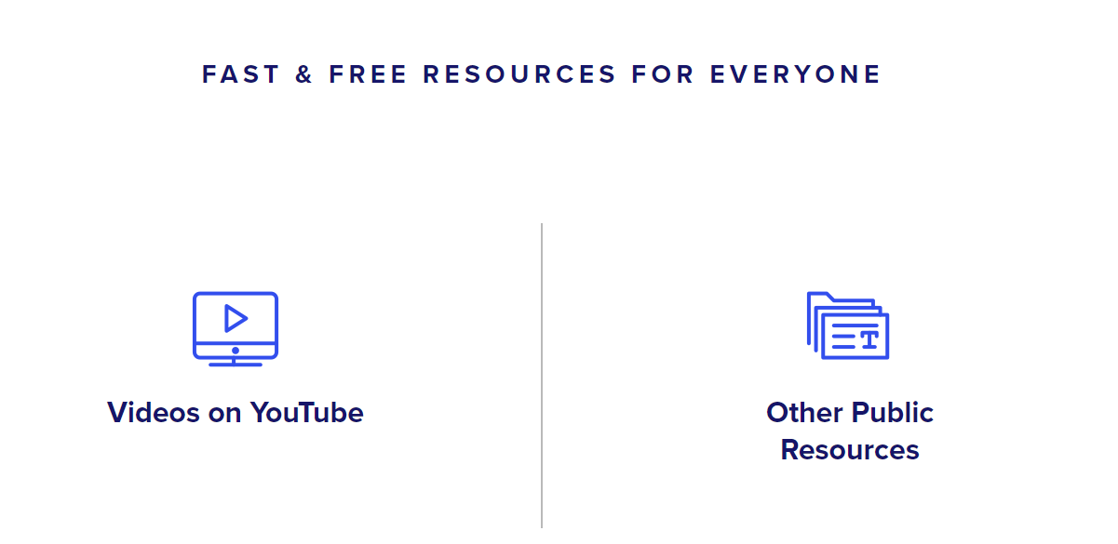
CALPADS
Training
&
Support
Timely Data Submission
Submit Quality
Data
Free training at: https://csis.fcmat.org/calpads-learning

Slide 43
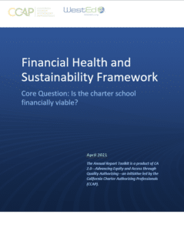




CCAP’s Toolkit
Financial Health & Sustainability Framework
Financial Framework
Performance Indicators
Template
  Link to the document

Slide 44

“If you can’t measure it, you can’t improve it.”
Peter Drucker
Are you measuring the right things?

Slide 45
Financial Framework Overview
CCAP’s Toolkit
Financial Health & Sustainability Framework

Slide 46
Fiscal Health
Near Term Indicators
The Framework includes three measures to evaluate a school’s financial performance
  Near-term
  Sustainability
  Fiscal Controls

Slide 47
Fiscal Health
Near Term Indicators
Current Ratio
Can the school pay its short-term obligations?
Cash On Hand
Does the school have the cash available to pay its bills?
Enrollment/ADA Variance
Does the school’s actual student enrollment and ADA support the projected revenue?
Unduplicated Pupil Percentage (UPP) Variance
Does the school’s actual UPP funding support the operating budget?
Reserve
Does the school have resources to weather uncertainties?

Slide 48
Fiscal Health
Sustainability Indicators
Operating Margin
Is the school deficit spending and has not made spending adjustments?
Debt Ratio
Ability to repay loan requirements within the fiscal year without additional borrowing.
Cash Flow From Current Operations
How much money the school has available to invest in new programs and negotiations.

Slide 49
Fiscal Health
Fiscal Compliance
Generally Accepted Accounting Principals
Does the charter school follow GAAP?
Financial Reporting
Are the Budget, Interim and Audit reports timely?

Slide 50
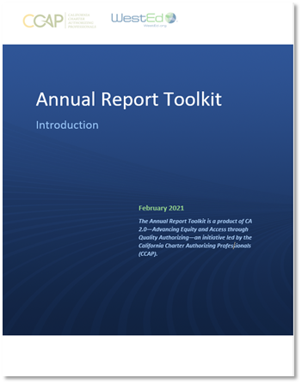
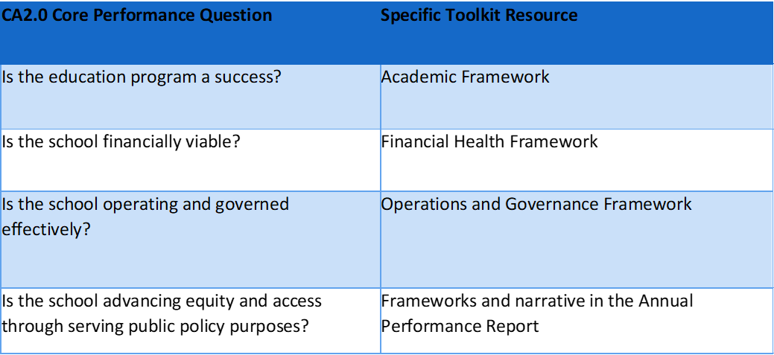
New Authorizer Toolkit
Annual Report

Slide 51
Highlights of the
Annual Report
Purpose
Convey school’s annual performance and performance trend over time
Assess school’s performance in light of renewal
Initiate conversation with school, differentiate oversight, adopt plan if needed
Annual Performance Report Components
Summary of school performance: Academic, Operational, Financial
Non-rated narrative addressing the fourth Core Performance Question
LCAP summary and overall Strengths/Areas for Improvement
Attachments
Completed Academic, Operational, and Financial Health frameworks
Site visit report

Slide 52
Considerations, Especially During COVID
The authorizer communicates results of monitoring to the charter school, laying a foundation for future decisions
Transparency is critical
Recognize these are extraordinary times; be flexible and supportive
Focus on student equity issues, especially pandemic-related
If the charter has serious problems, then work closely with them to support
Fiscal, compliance, and governance are higher risk during pandemic
Maintain a positive and professional relationship
Assume best motives -- unless provided with factual information to the contrary
Notes:
Tom

Slide 53
RESOURCES & CCAP LINKS
California Charter Schools 201: High-Quality Authorizing
Also, Charter Schools 101
Charter Authorizing 2.0: Advancing Equity and Access Through Quality Authorizing
CCAP Charter School Authorizing Conference
Upcoming CCAP Professional Development Webinar Schedule
Financial Health & Sustainability Framework Toolkit
Annual Report Toolkit
CCAP Newsletters and News & Updates

Slide 54
Contact info
    You have Questions? We have answers!
    Tom Hutton, Executive Director: tom.hutton@calauthorizers.org
  David Patterson, Board President: david.patterson@calauthorizers.org
  Debi Deal, Treasurer: ddeal@brightlake.com
  OR: info@calauthorizers.org

Slide 55
Thank you!

